Slide 1

DIGITAL HEALTHCARE
MANAGEMENT
Team SAP
Aditi Jain 001038953 Prerana Urs Praveen Kumar Urs 001553207
Suhani Shah 001567040

Slide 2
PROBLEM STATEMENT
Patient health is the priority in solving any health care problem. Best doctors to consult may not be available in their city for patient’s disease. To find a doctor across networks and enterprises is the key to make patient’s health improve faster. Also, it is necessary for a healthcare system to organise itself well enough to implement a smooth process, specially while associated with a medical emergency. The system should focus efforts on the right activities & optimize engagement to a build closeable pipeline. Standardize workflows should be there so that focus is on providing best health care facilities rather than reporting and documenting records. The process should be well maintained and digitised to achieve value from partnership of various enterprises that should benefit patients.
Notes:
Focus efforts on the right activities & optimize engagement to a build closeable pipeline. Standardize workflows for consistent efforts on the best

Slide 3

PROPOSED SOLUTION
The main focus of our application is to enable patients get the best service of doctors from anywhere in the globe. Also, to send and receive medical requests from one role to another within the ecosystem in order to provide efficient and timely treatment to the patients. Here, the patient’s medical needs are satisfied within a single ecosystem without facing any hassle. Also, maintaining patient’s database in the ecosystem saves time during future emergencies and helps the hospital management to attend and proceed further with associated processes.

Slide 4

PURPOSE
A global and efficient healthcare system that allows to handle different directions of clinic, hospital, lab, pharmacy and insurance workflows across the network. To manage the smooth healthcare performance along with administrative, medical and financial control. Our application helps in following a methodology from patients booking appointment prior to their visit with the Doctor and ongoing processes based on the patient’s medical requirements.

Slide 5
ADDITIONAL FEATURES
▰ Email Confirmation Sent to User on account creation
▰ SMS Confirmation Sent to User on account creation
▰ Patient can set their location using Google Maps
▰ Notification Broadcasted to relevant authority for
response in Ecosystem platform
▰ View a report graph of all the appointments type and
beds availability in an enterprise as well as across all
enterprises in the system

Slide 6
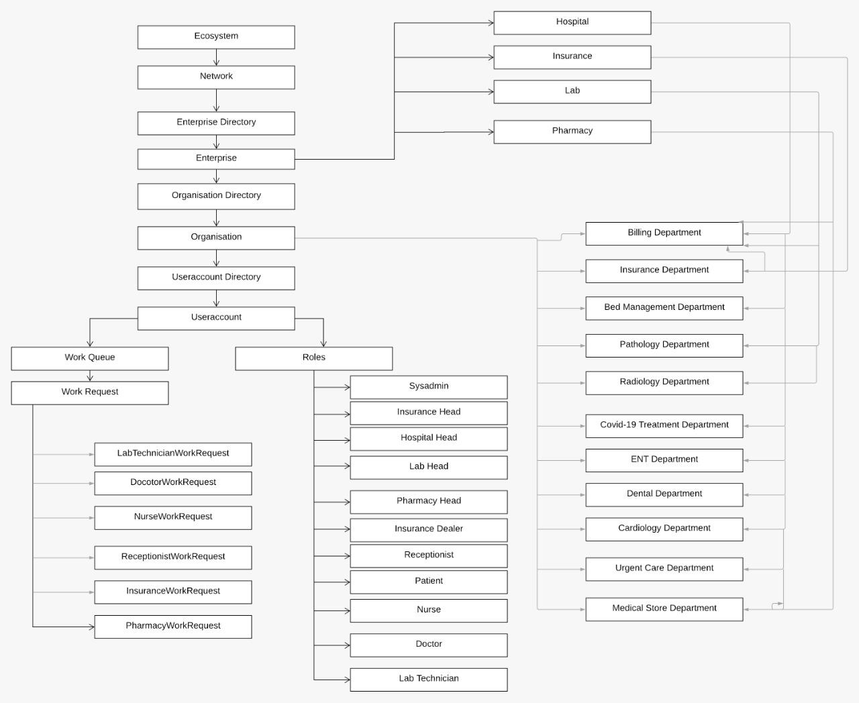
ECOSYSTEM ARCHITECTURE DIAGRAM

Slide 7
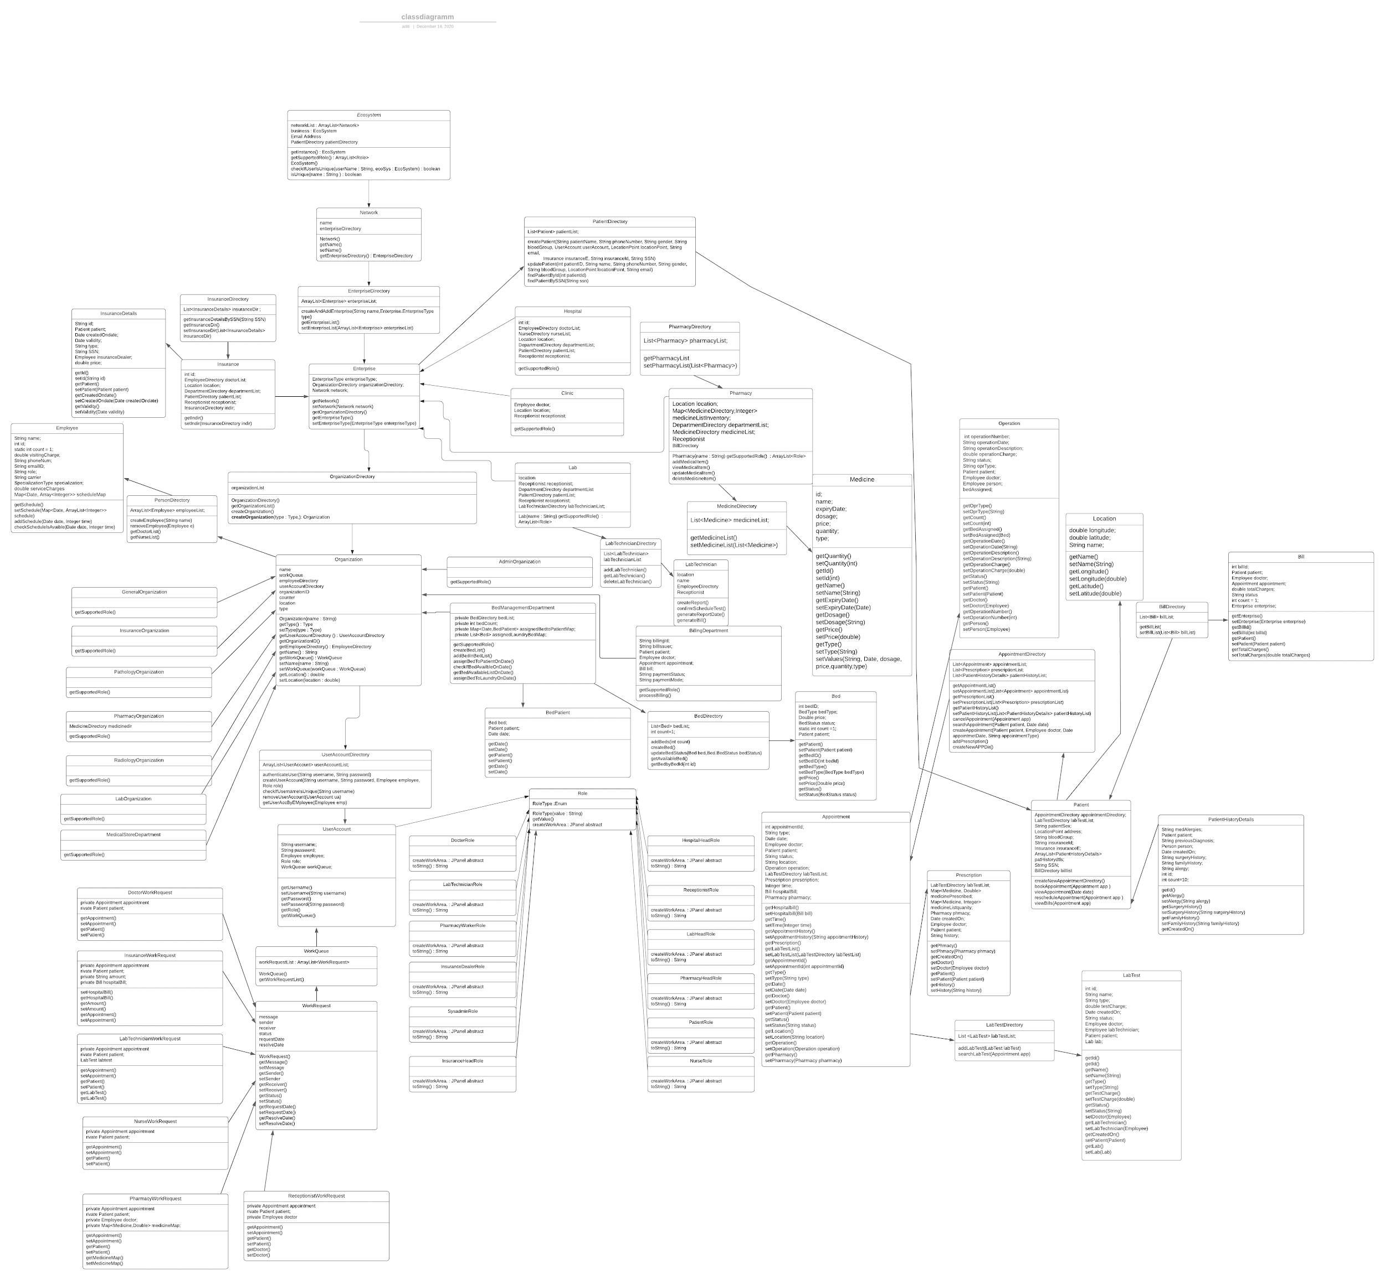
UML DIAGRAM

Slide 8
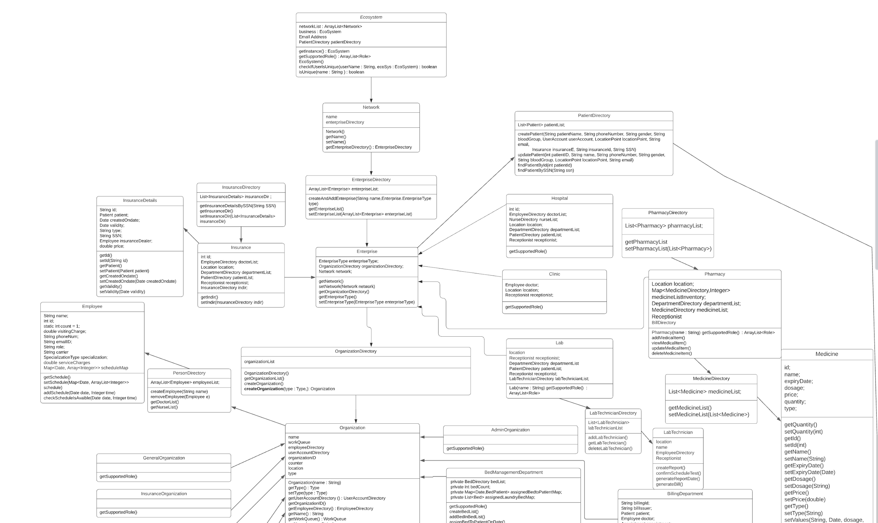
UML DIAGRAM (continued)

Slide 9
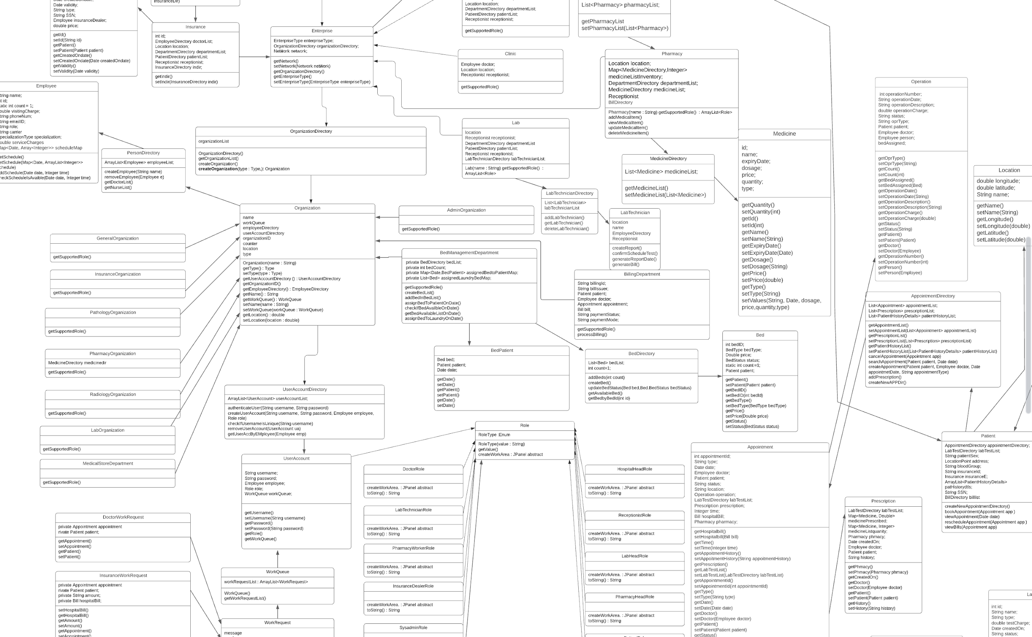
UML DIAGRAM (continued)

Slide 10
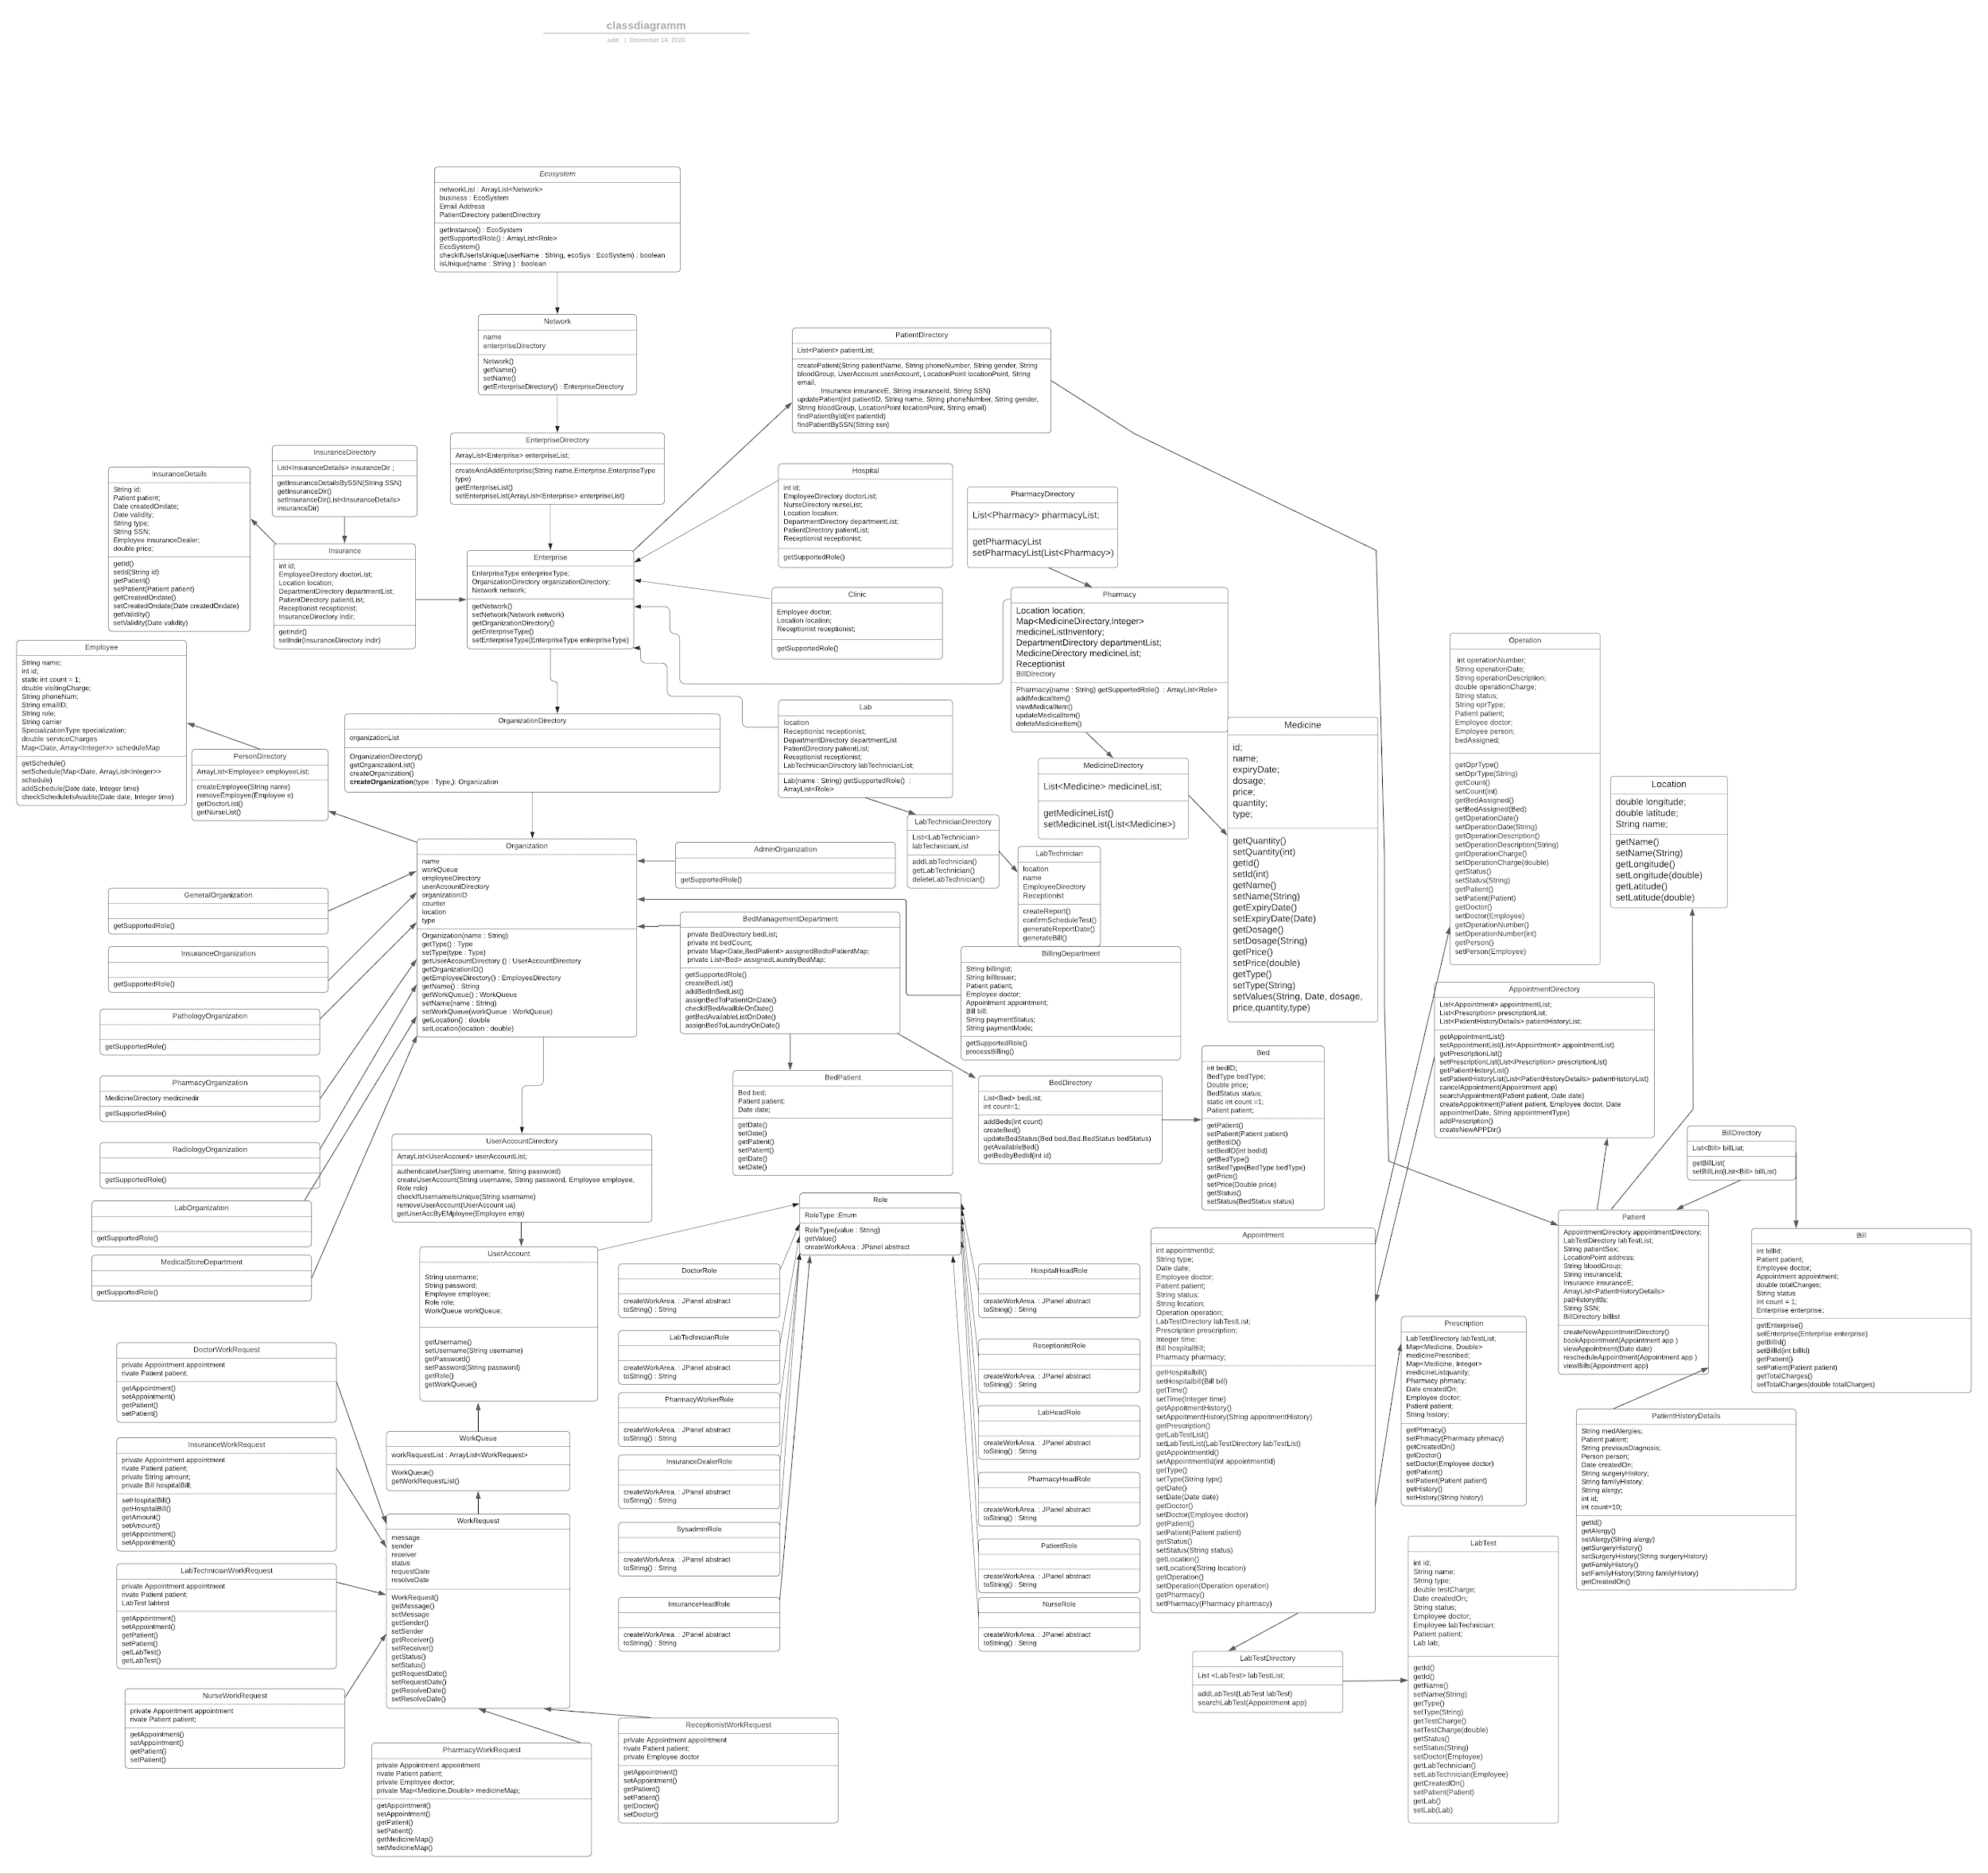
UML DIAGRAM (continued)

Slide 11
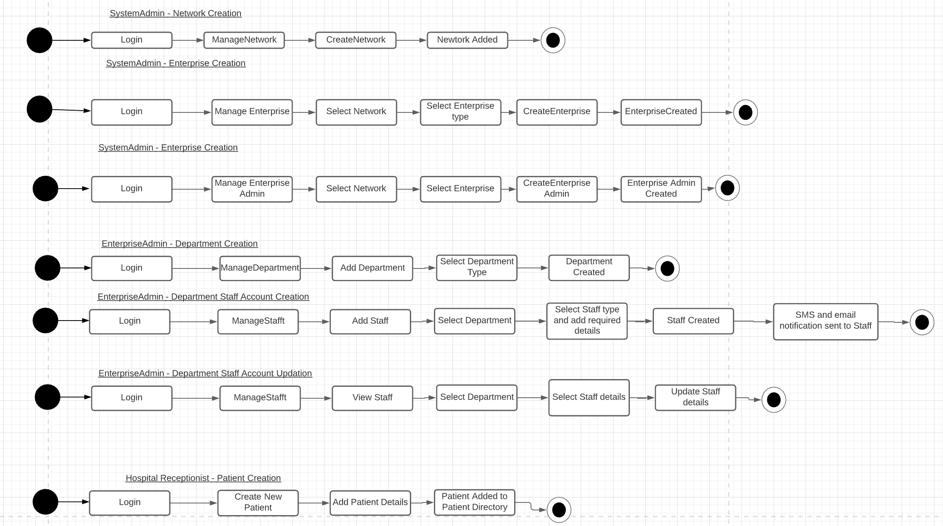
WORKFLOW

Slide 12
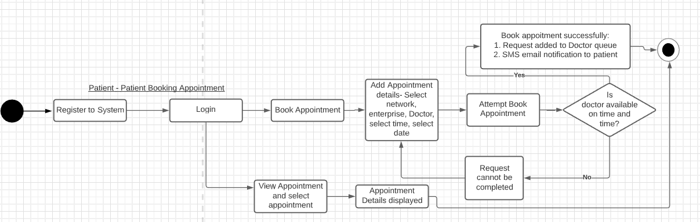
WORKFLOW (continued)

Slide 13
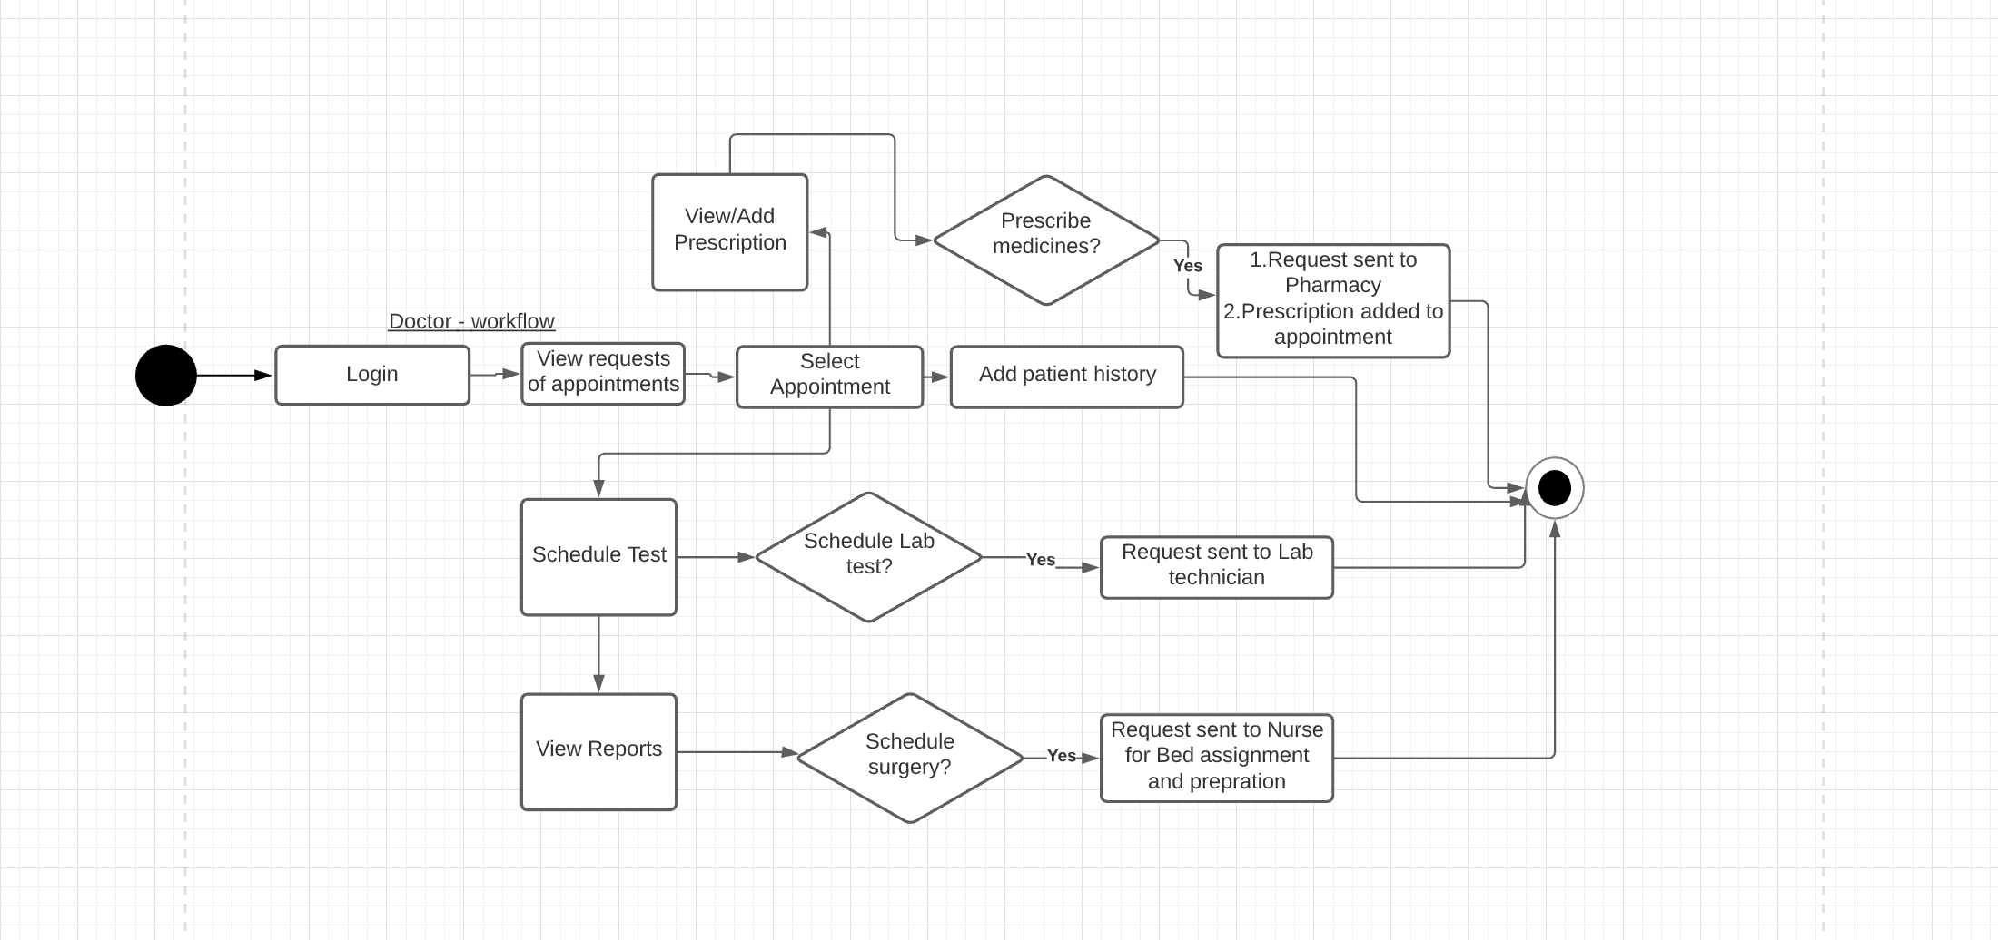
WORKFLOW (continued)

Slide 14
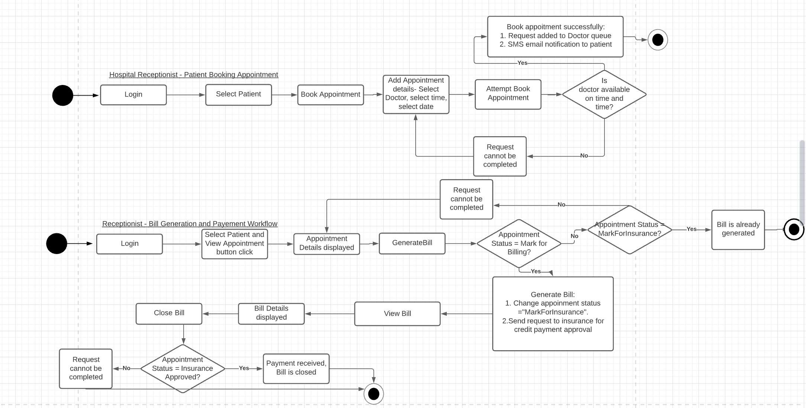
WORKFLOW (continued)

Slide 15
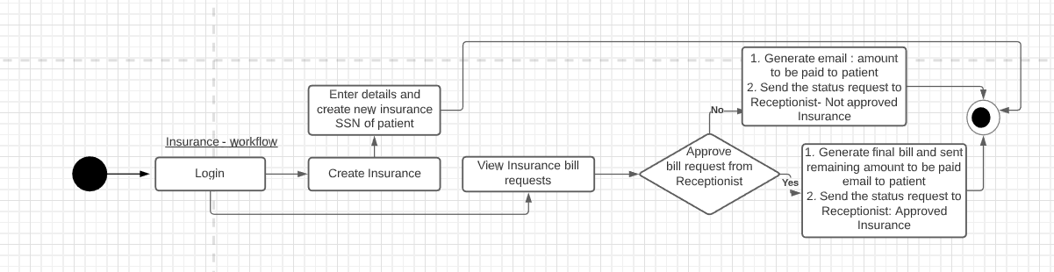
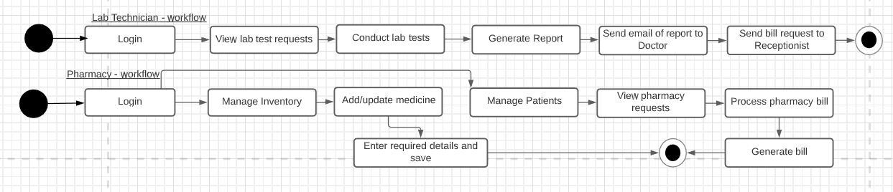
WORKFLOW (continued)

Slide 16
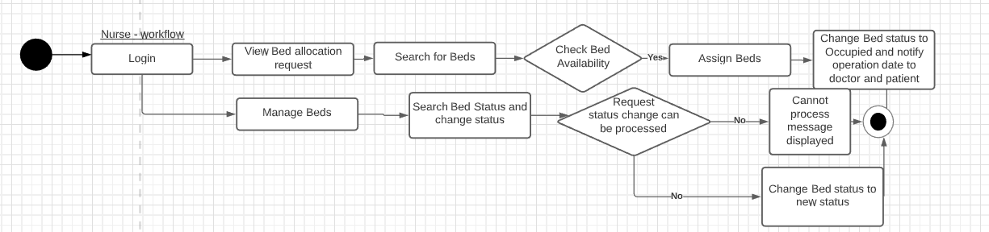
WORKFLOW (continued)

Slide 17

ROLES & FUNCTIONS
Enterprise Admin
Admin’s responsibility is to manage various departments and staff of the enterprise, send sms and email notifications on account creation.
Receptionist
The responsibility of Receptionist is to manage appointments for the patients considering the Doctor’s availability and process bills.
Doctor
Doctor plays the important role of seeing patient, scheduling lab tests, surgeries and prescribing medicines based on the patient’s current health and history.

Slide 18
ROLES & FUNCTIONS
Nurse
Nurse plays the role of managing beds in the Hospital based on the patient admissions.
Patient
Patient’s role is to register to system, book appointments, make the total payment based on different charges - Doctor consultation charges, Lab test charges, pharmacy medicine charges with respect to the insurance amount claimed by the patient.
Pharmacy Head
Pharmacy head manages medicine inventory along with staff and department.

Slide 19
ROLES & FUNCTIONS
Pharmacist
Pharmacist receives a work request from the Doctor based on the medicines prescribed for the patient and generates a pharmacy bill after calculating the total dosage and quantity of medicines.
Insurance Dealer
Insurance Dealer receives a work request from various enterprises to approve insurance amount to complete payment process. Insurance dealer also issues new insurance for patients.

Slide 20
ROLES & FUNCTIONS
System Admin Role
The responsibility of this role is to create enterprises, networks and enterprise accounts.
Lab Technician
Lab technician receives a work request from the Doctor based on different lab tests that needs to be performed on the patient. Generate a test report once the test is completed and send to Doctor.

Slide 21
KEY FEATURES
▰ Patient registers to system and books an appointment
of doctor across network
▰ Patient is notified on appointment booking
▰ Patient receives updates on his doctor’s appointment
status change
▰ Doctor sees the patient either online or in-person and
starts the process for improving patient’s health
▰ Doctor prescribes medication, sends request for
conducting test to lab and schedules an operation

Slide 22
KEY FEATURES
▰ One Patient cannot book more than one appointment at a
time with one doctor
▰ Patient history is maintained across all visits of patients
▰ Faster reporting and documenting - digitised the process
▰ Value is in partnership of different enterprises to help
patients receive best health care services.
▰ Bed Management is done to provide count of available
▰ Pharmacy maintains medicines inventory and fulfills
patients’ medication needs

Slide 23
KEY FEATURES
▰ Insurance company provides insurance for medical bills
▰ Insurance dealer approves or disapproves the request based
on policy and processes payment
▰ Receptionist can also book appointments on-behalf of
Patients (in emergencies), manages bills and payments
▰ Nurse manages bed assignment in the hospital enterprise
▰ Test Reports are sent to doctor for analysis through
email by lab technician after completing the tests

Slide 24
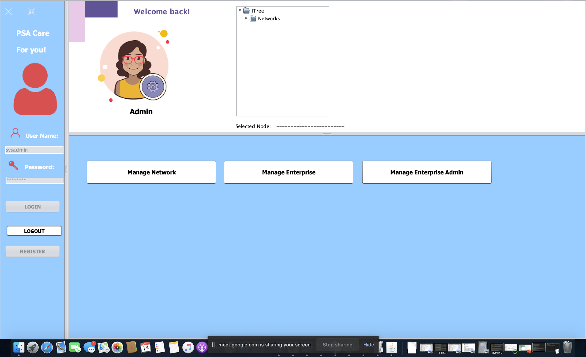

Slide 25
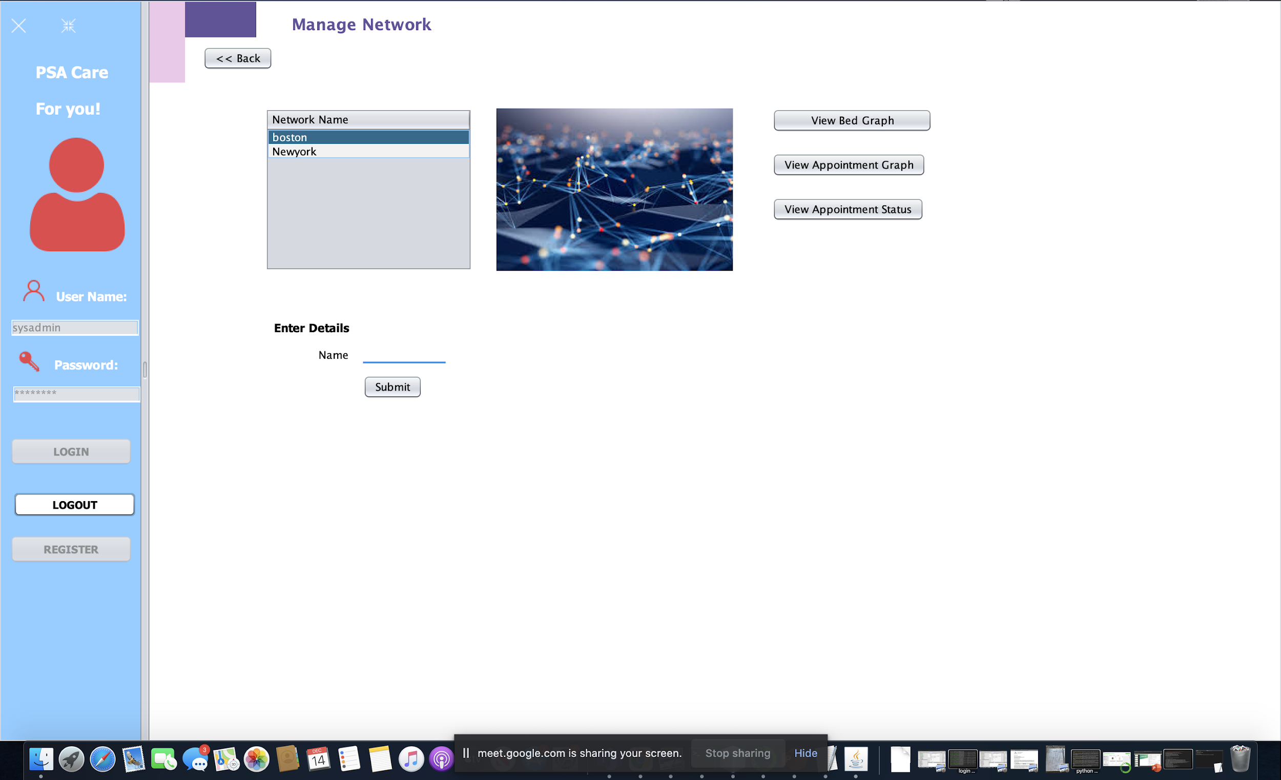

Slide 26
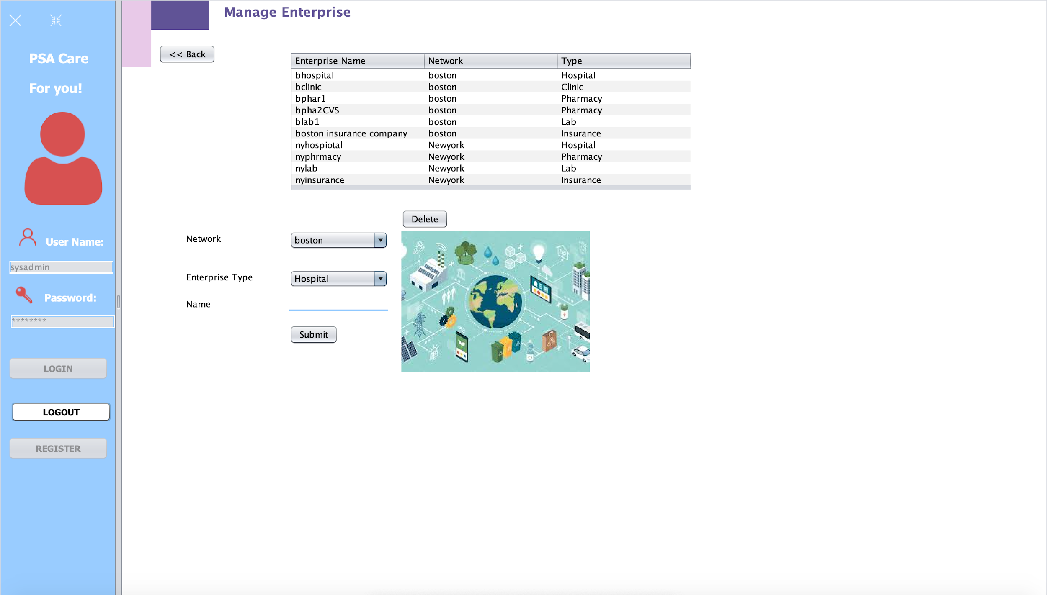

Slide 27
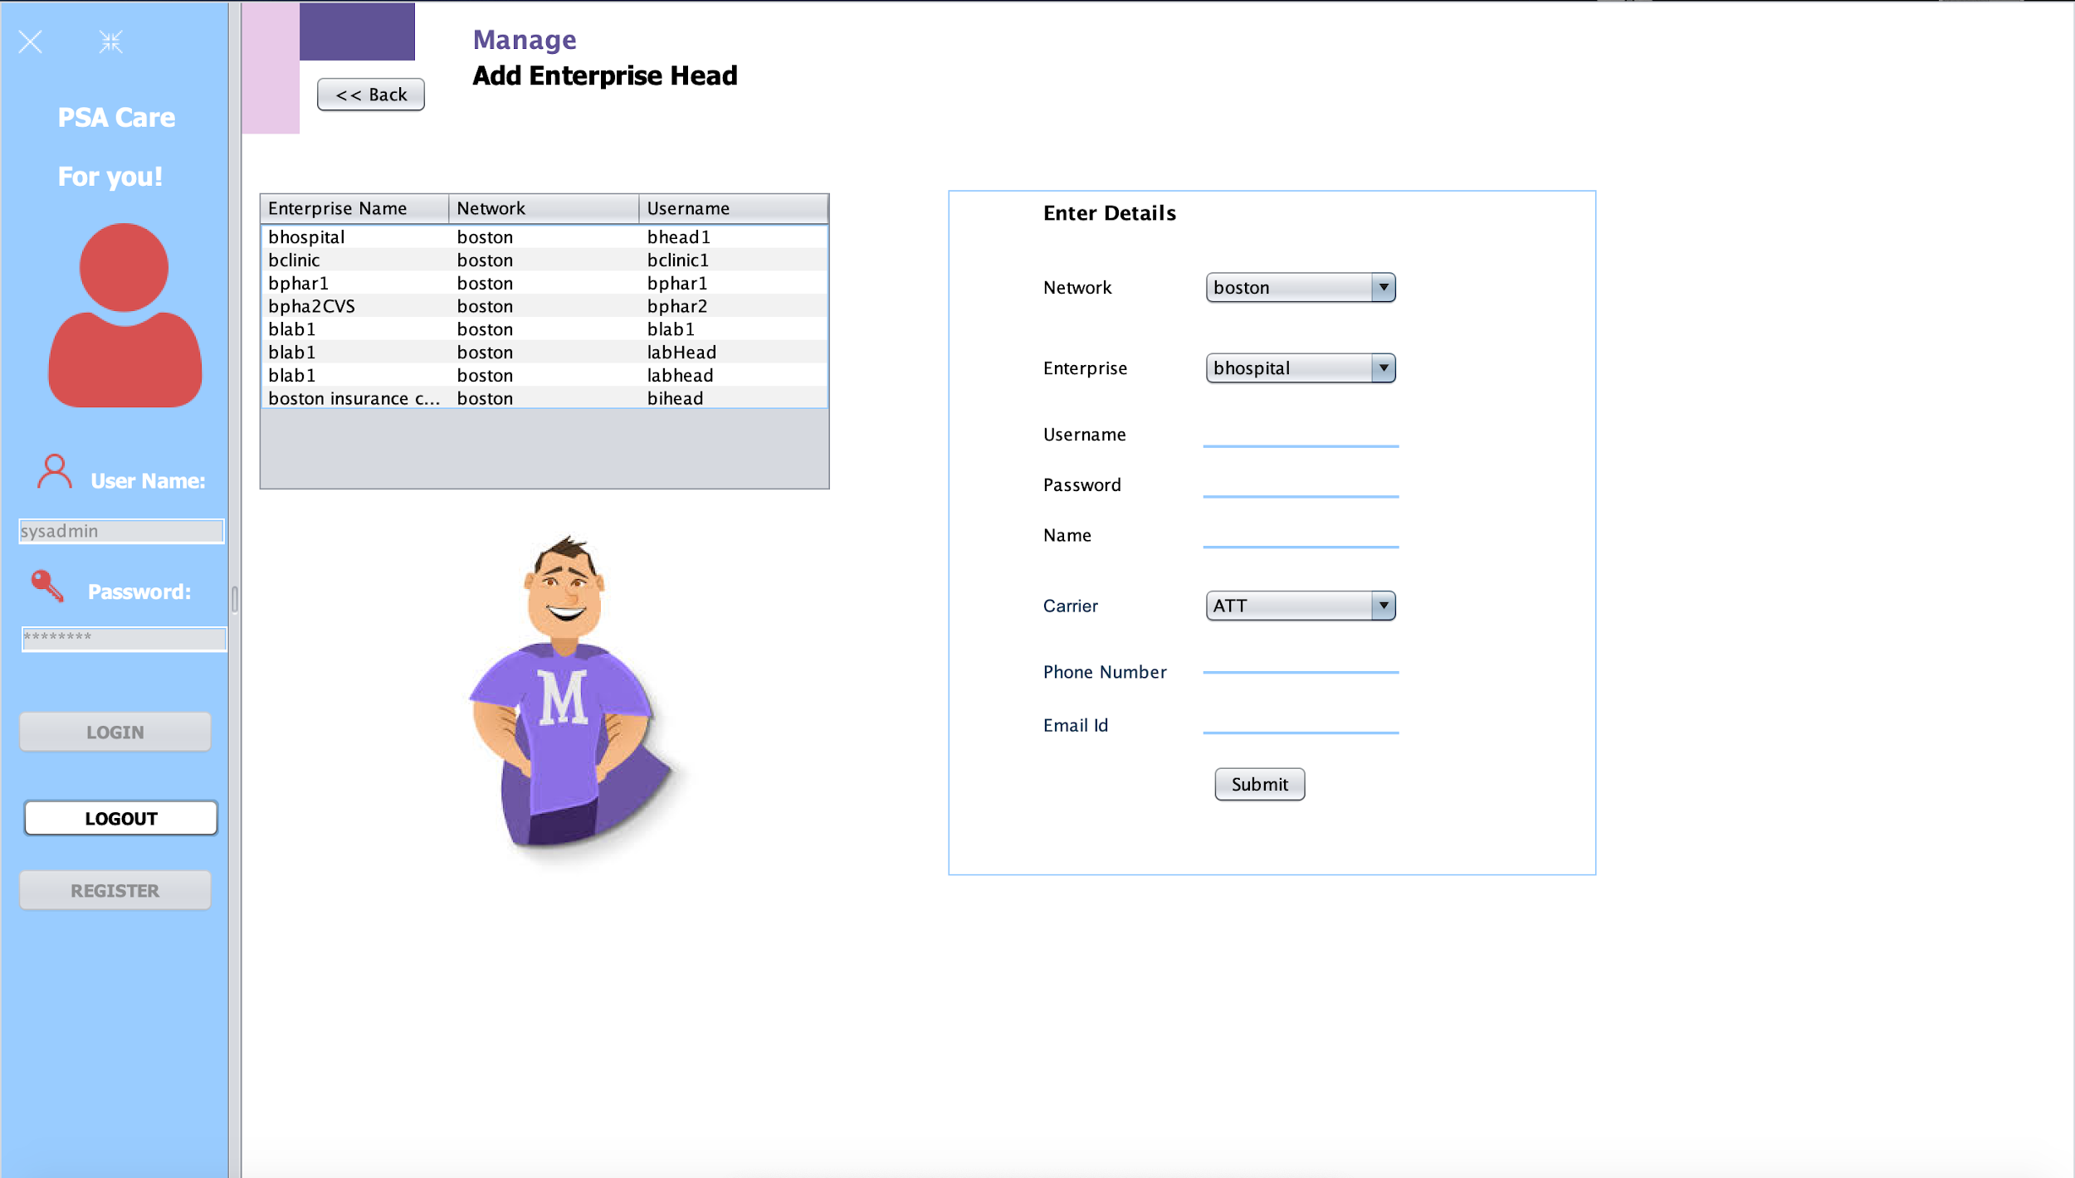

Slide 28
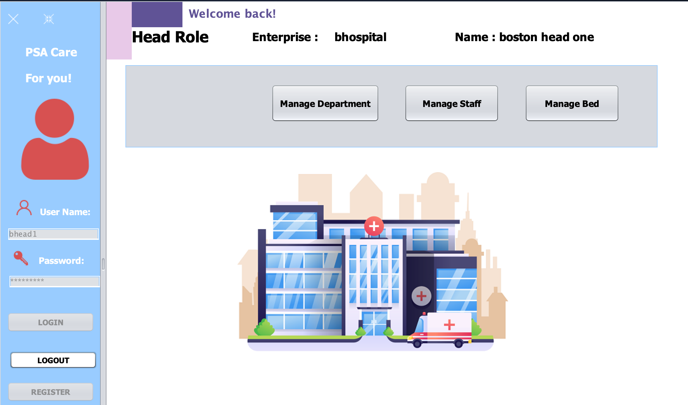

Slide 29
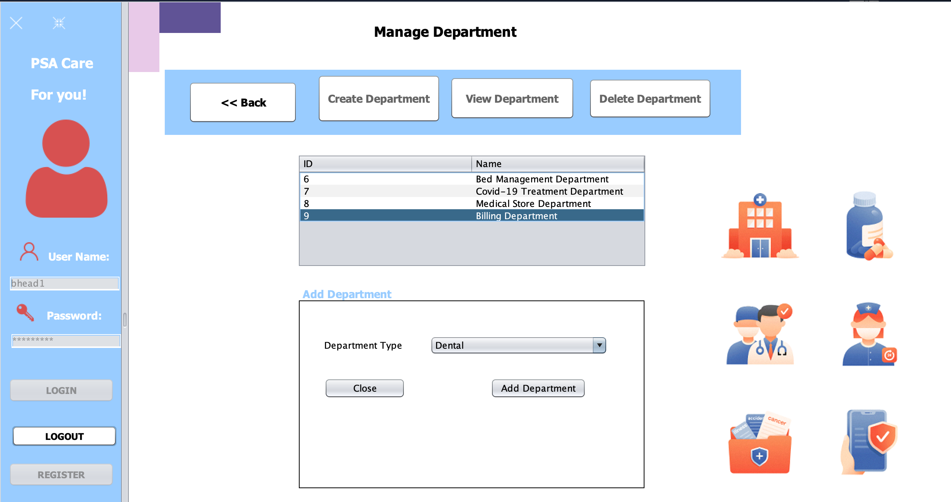

Slide 30
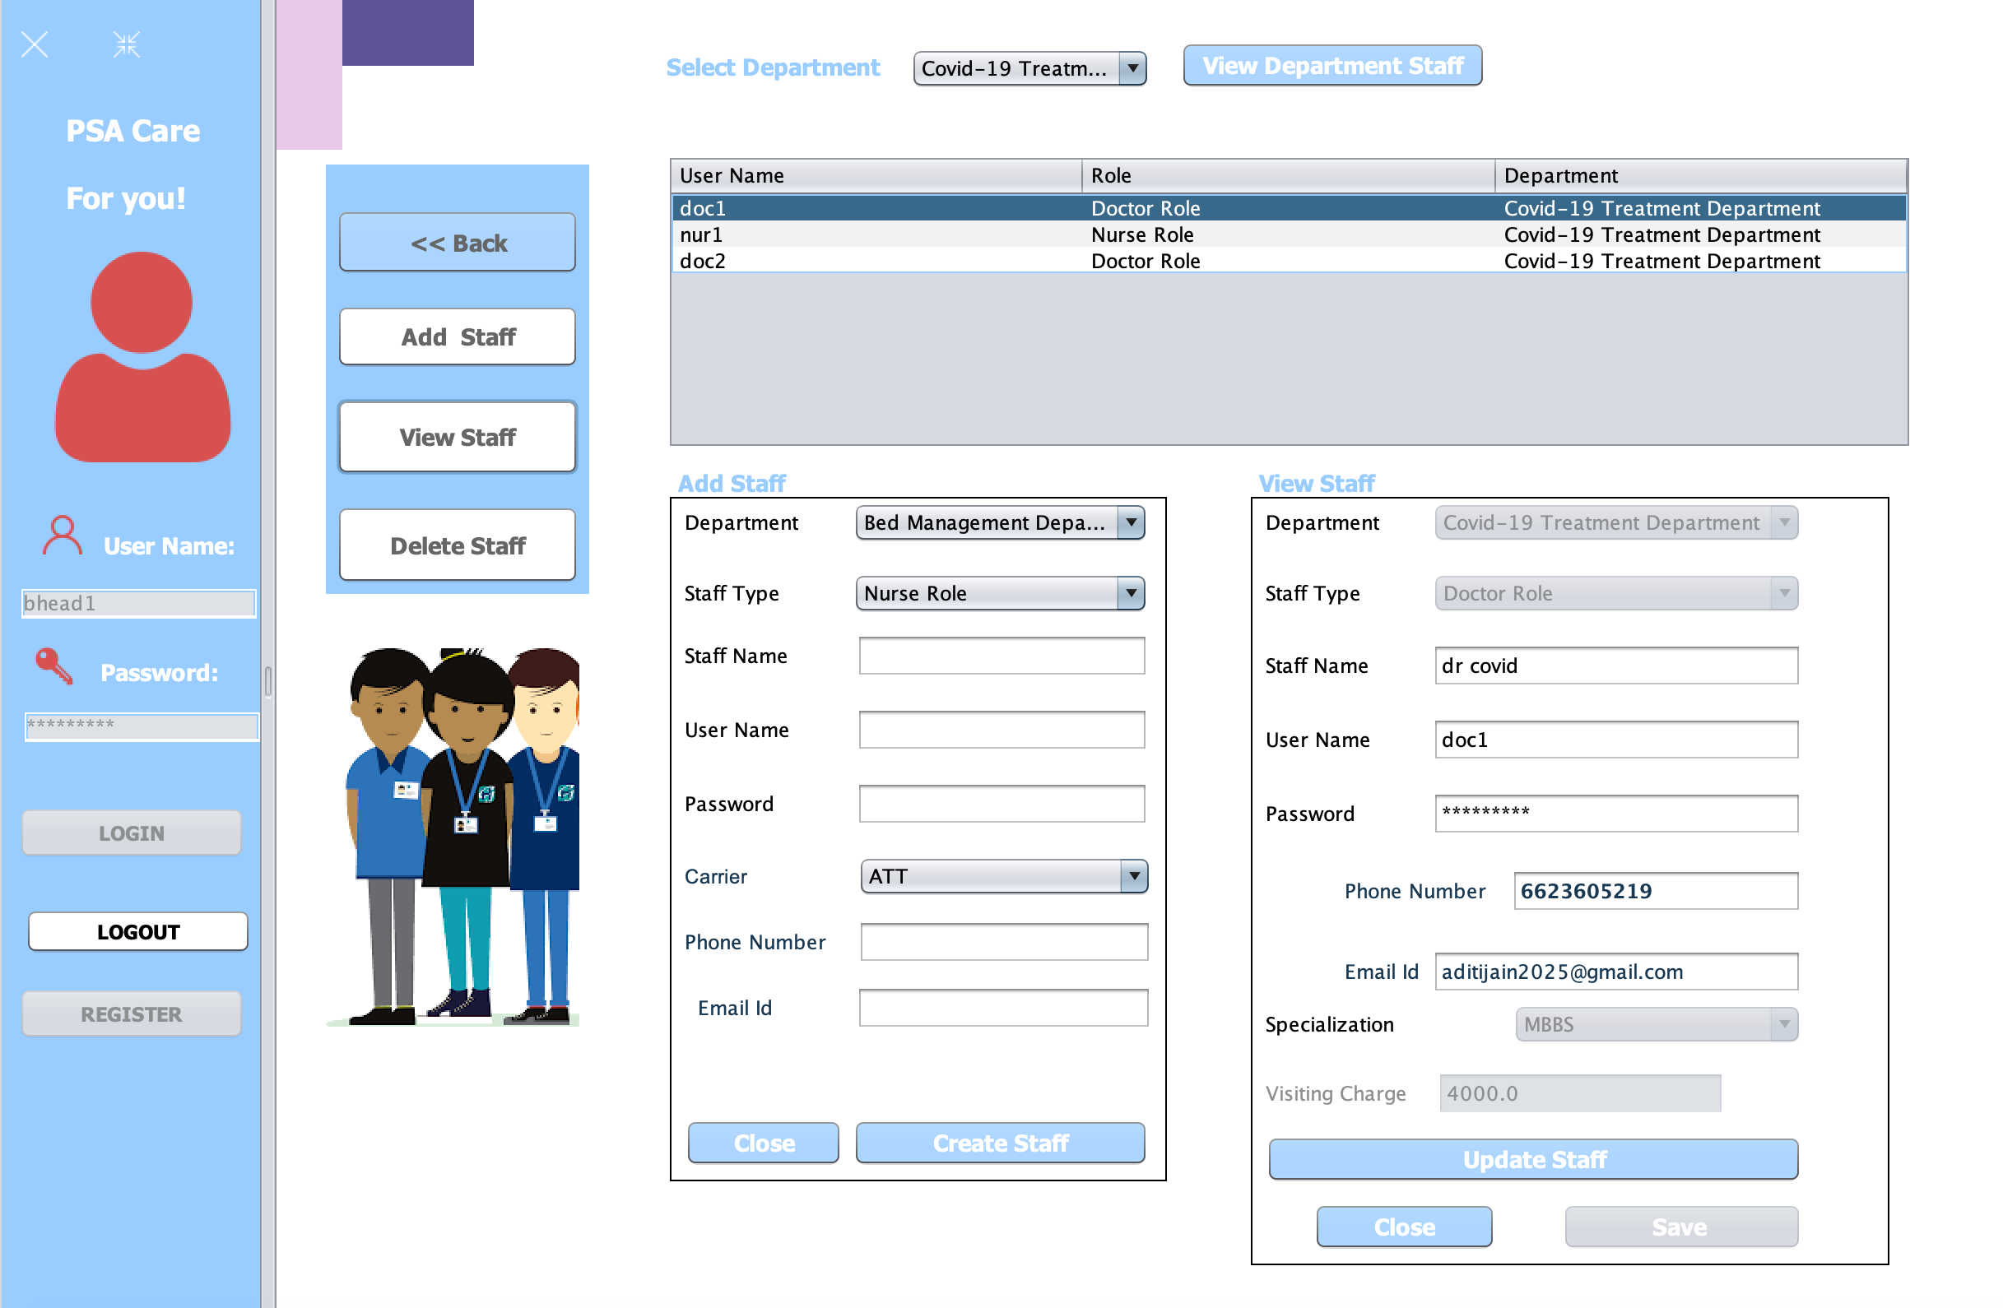

Slide 31
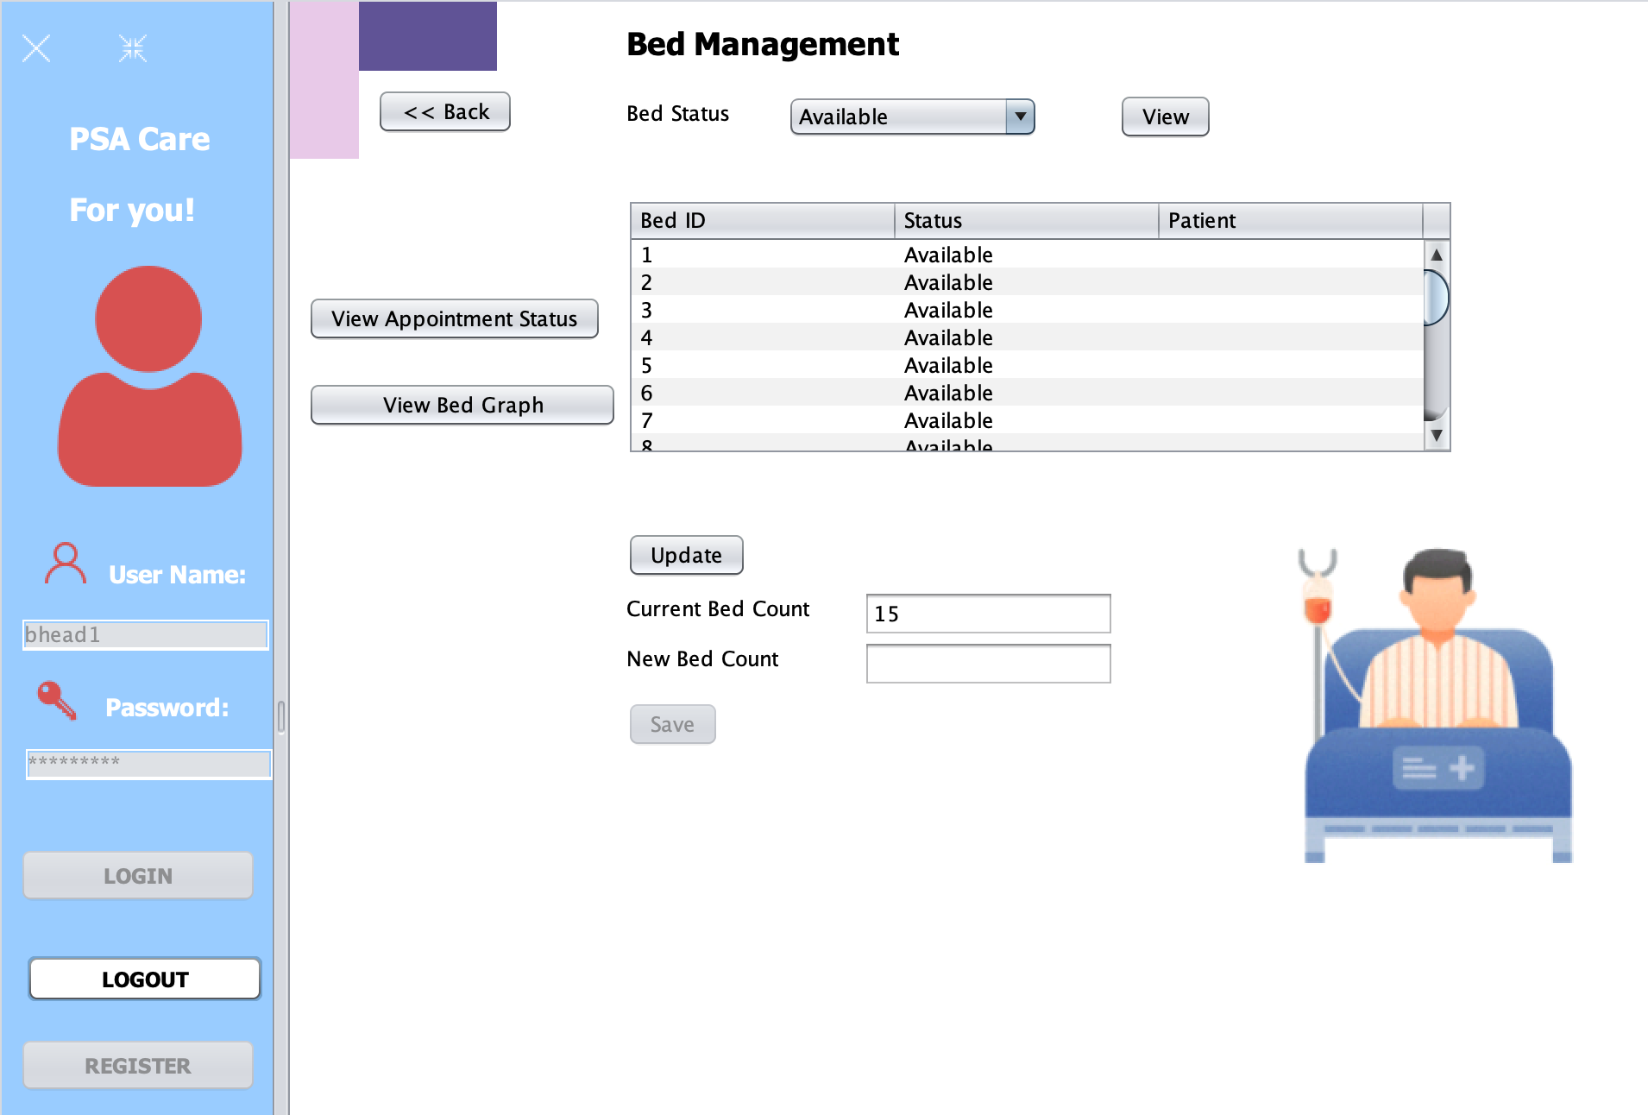

Slide 32
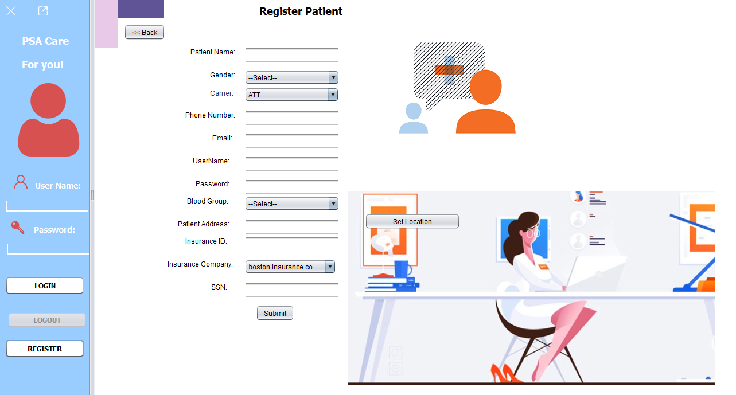

Slide 33
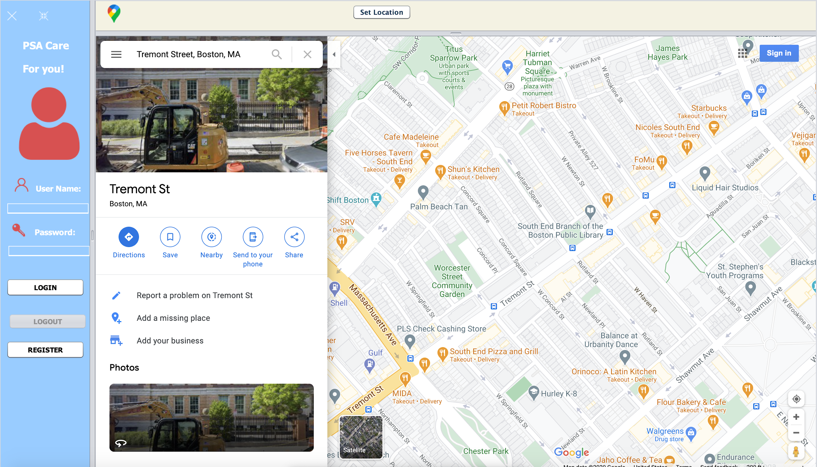

Slide 34
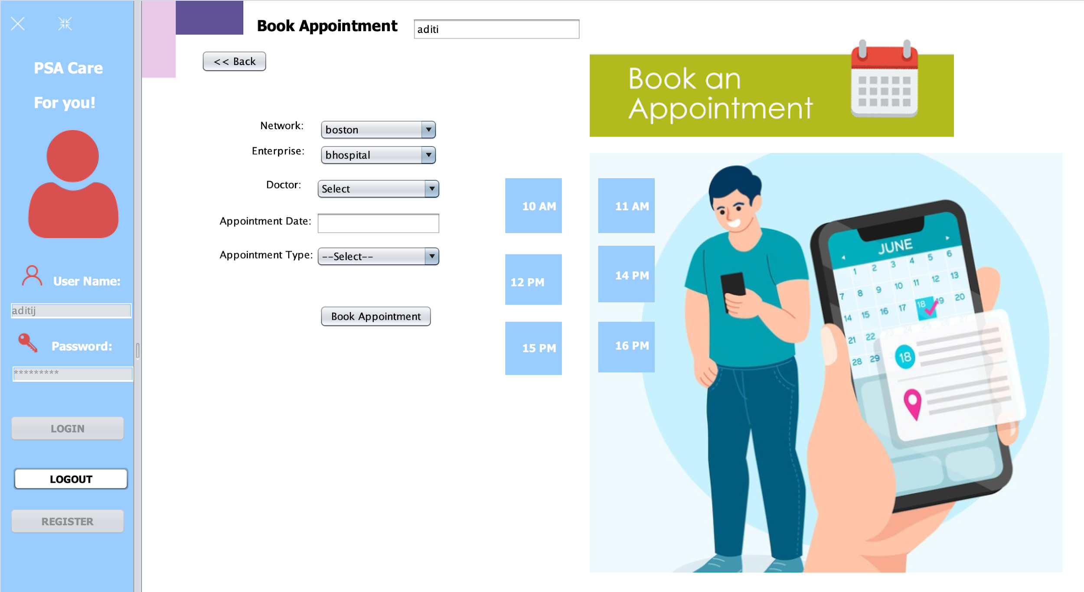

Slide 35
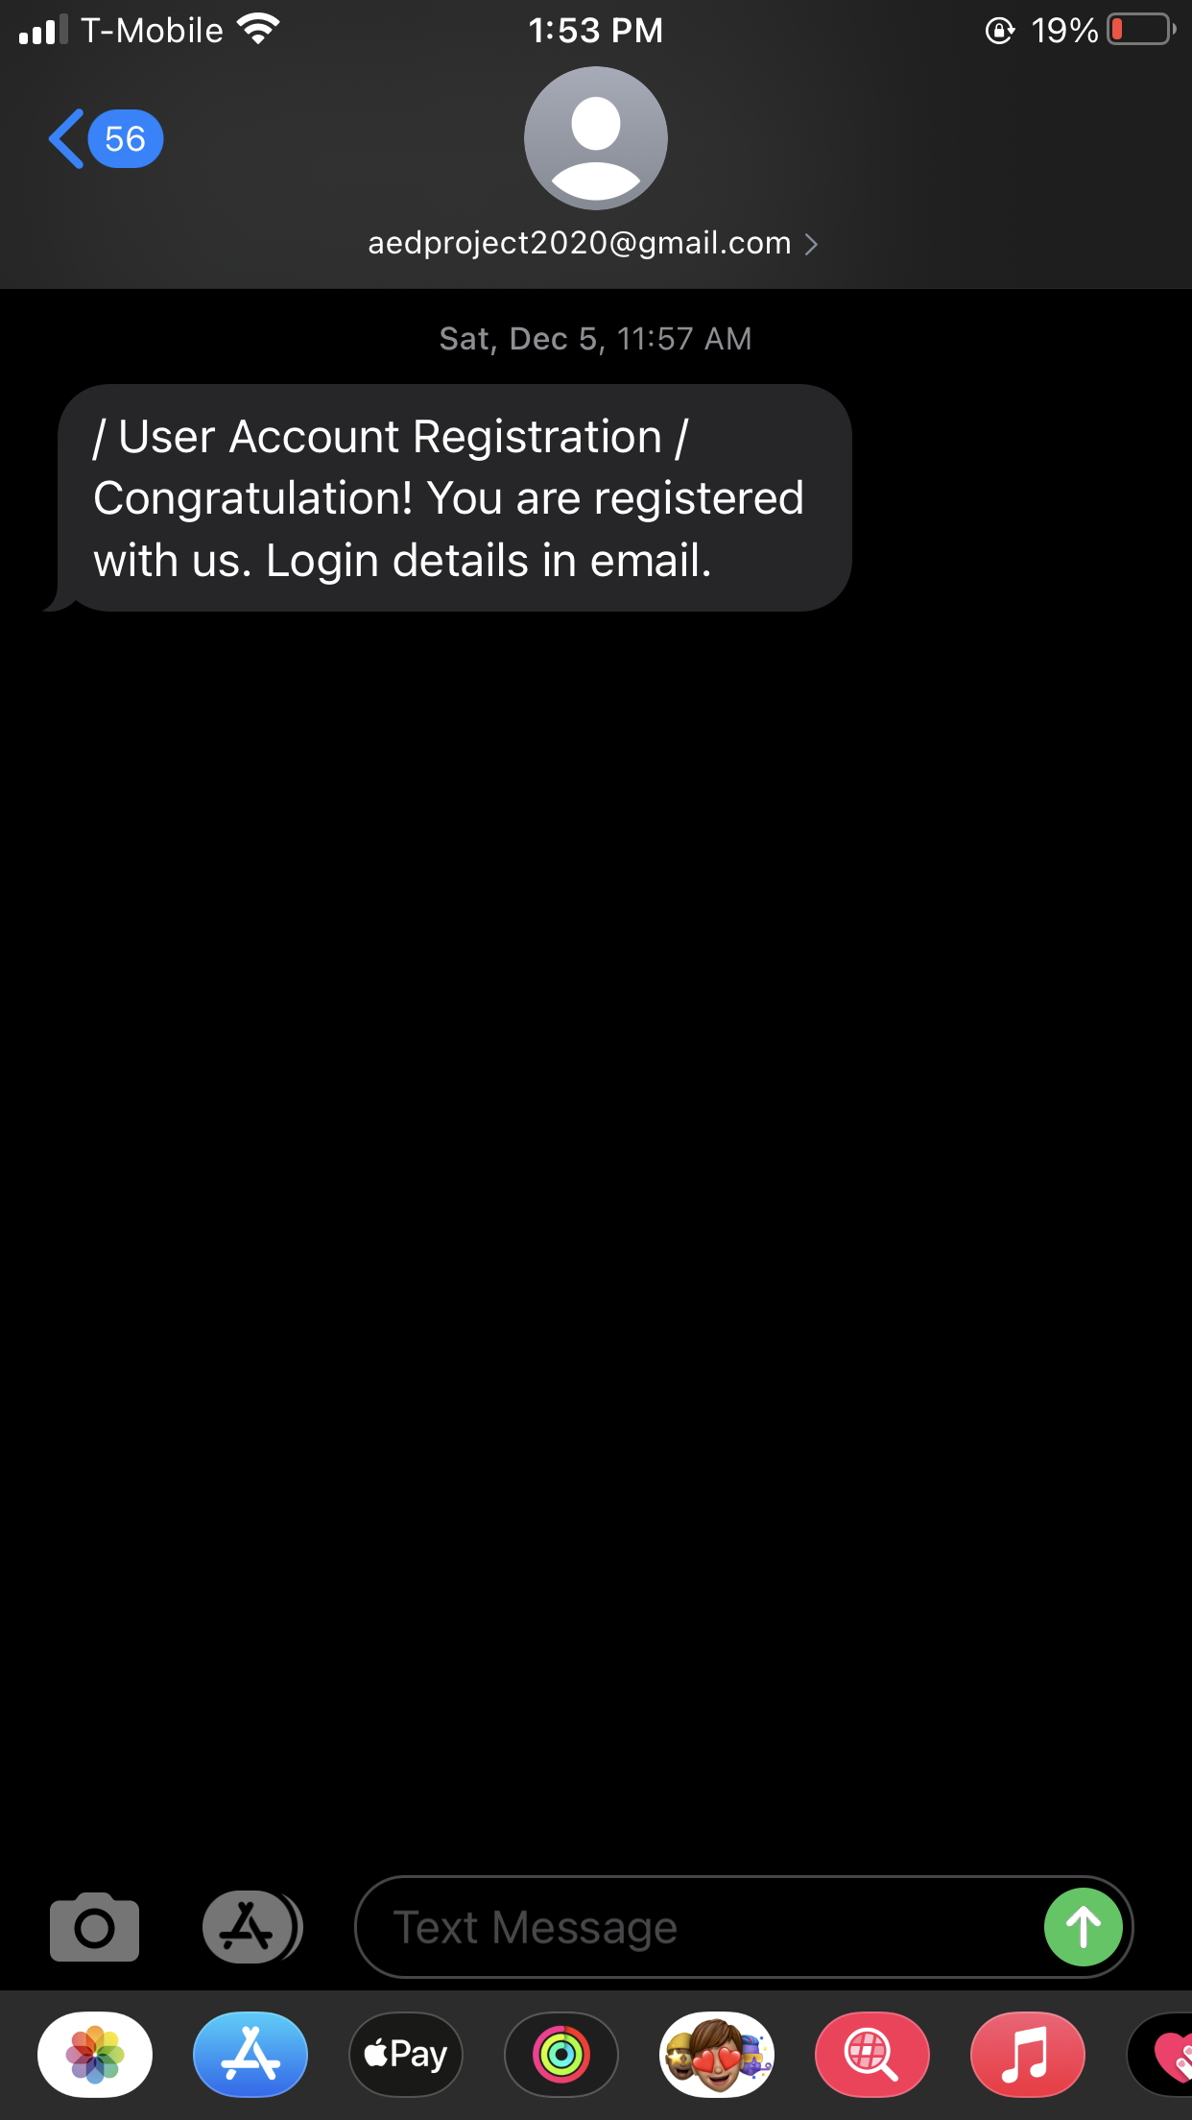
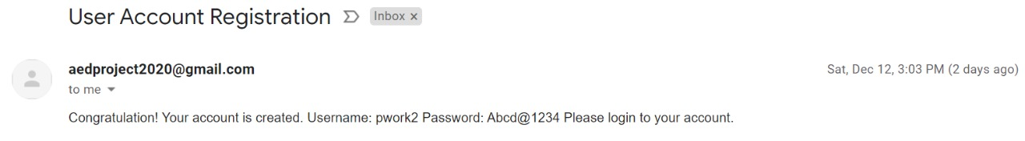
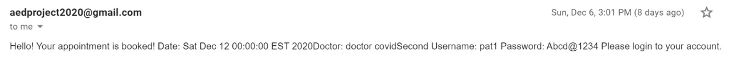
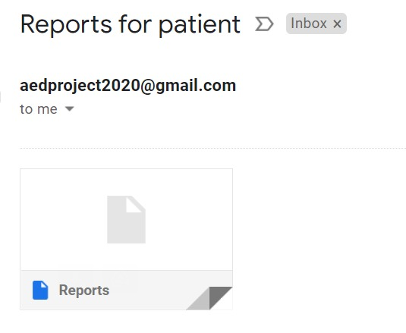

Slide 36
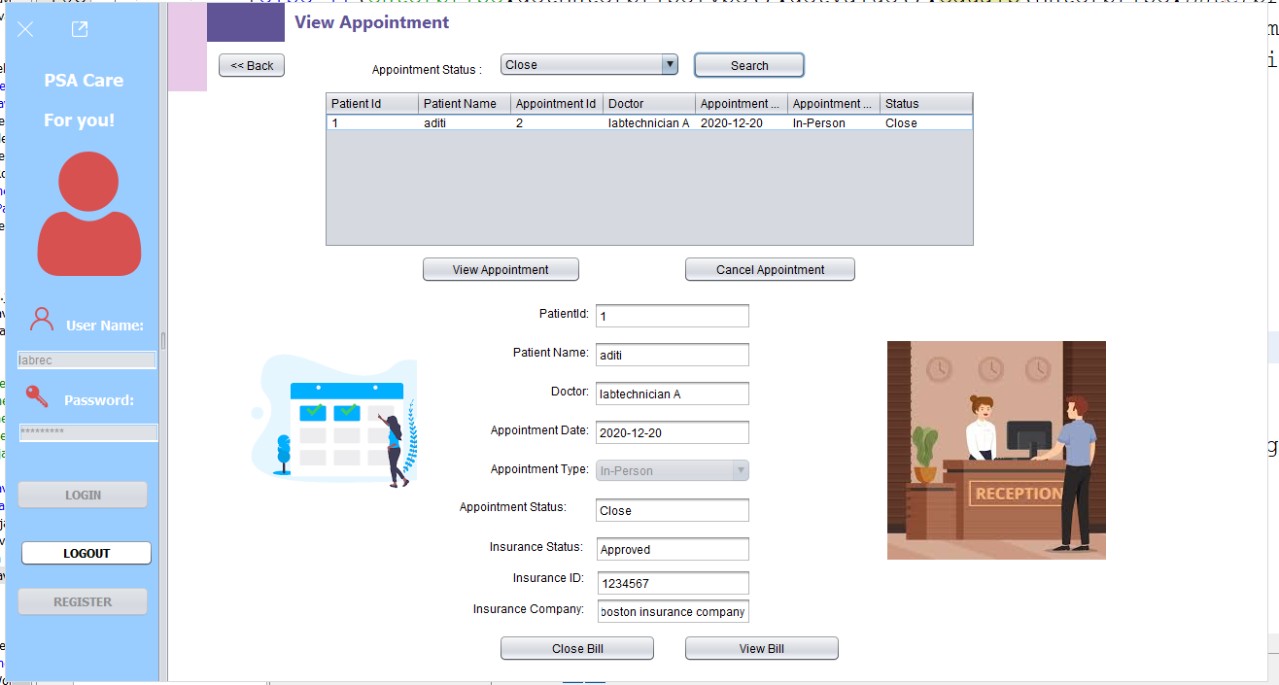

Slide 37
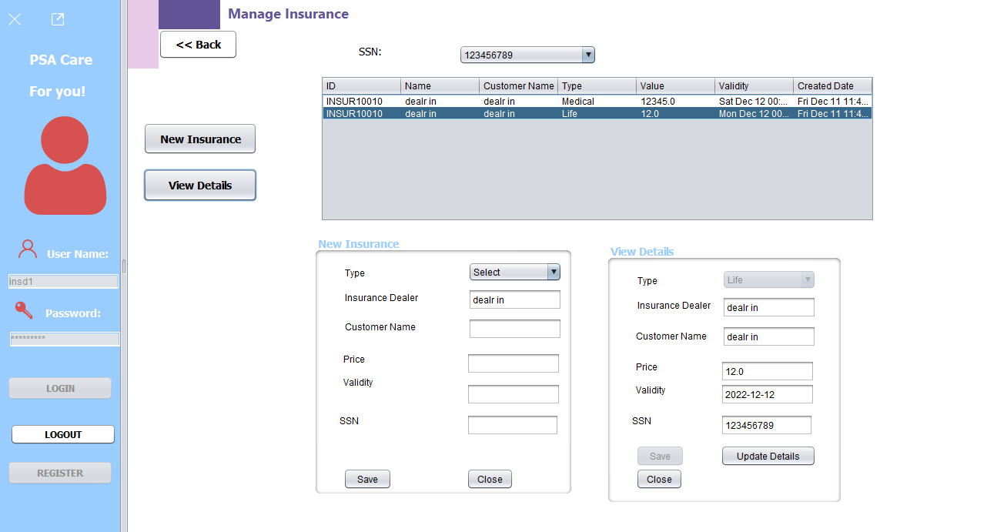

Slide 38
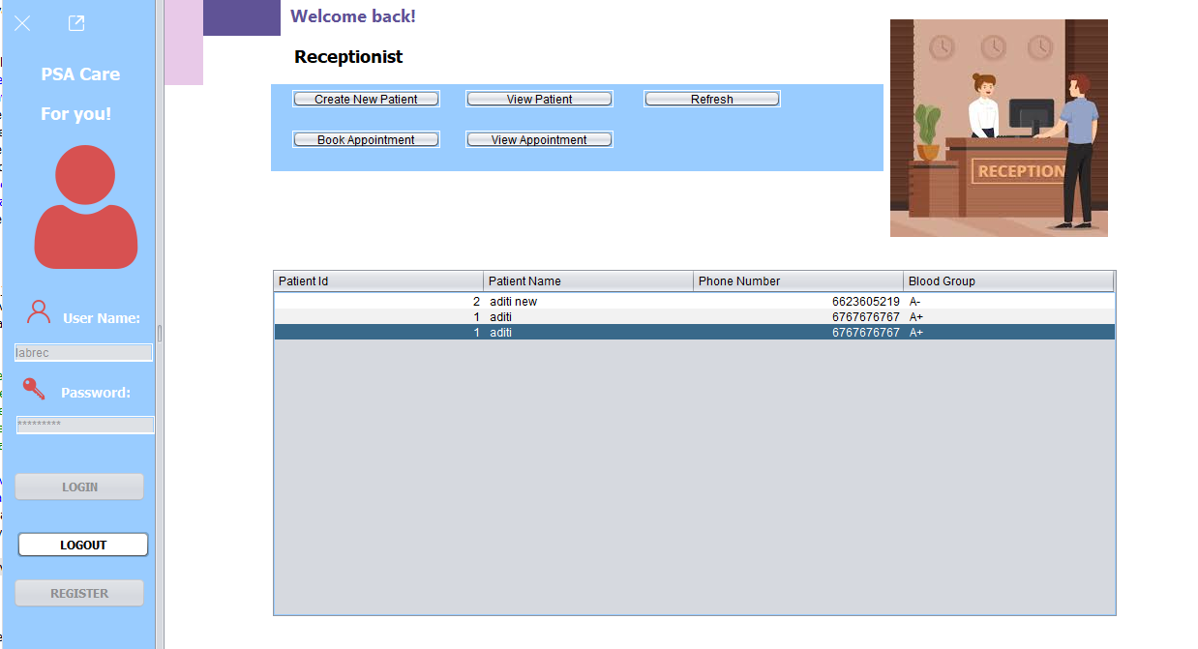

Slide 39
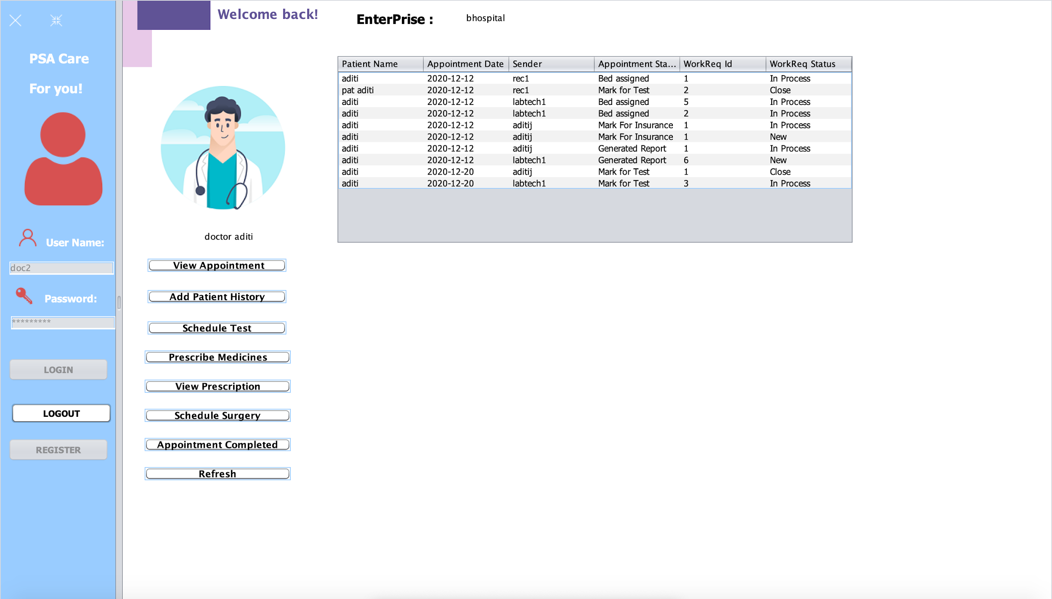

Slide 40
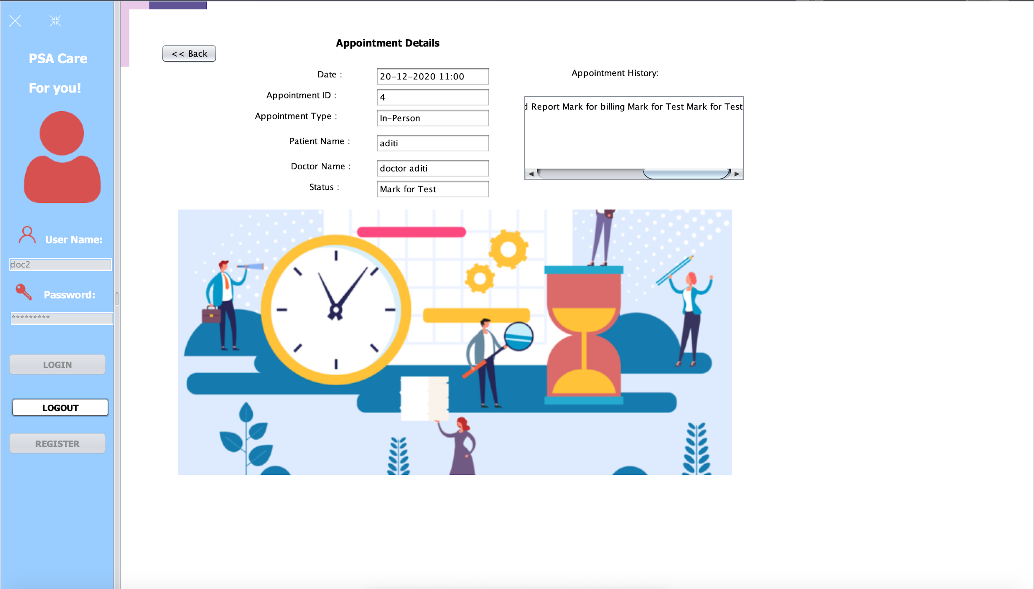
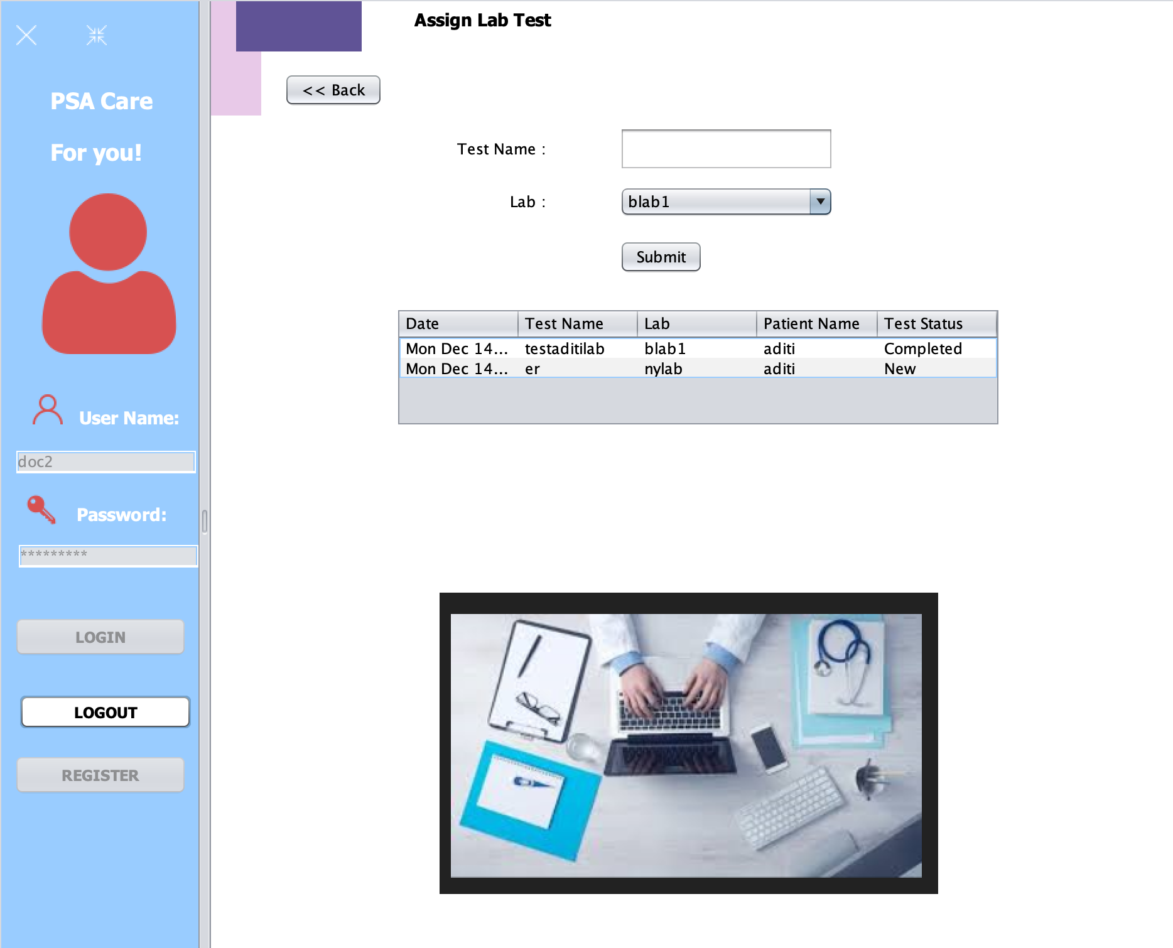

Slide 41
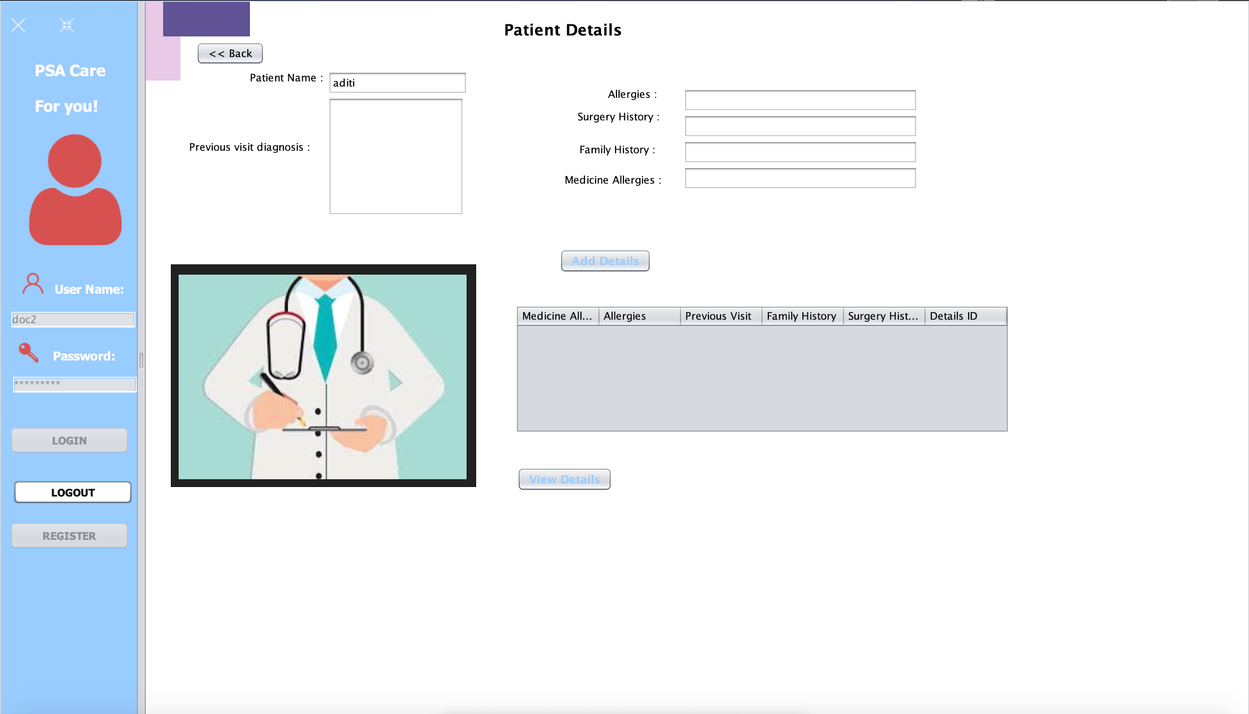

Slide 42
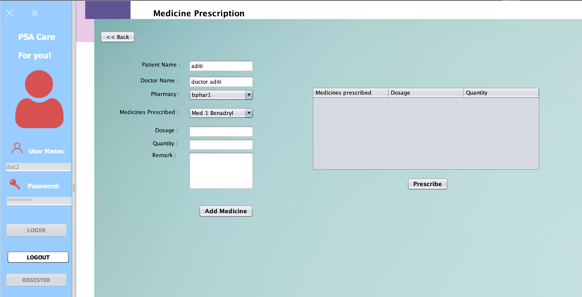

Slide 43
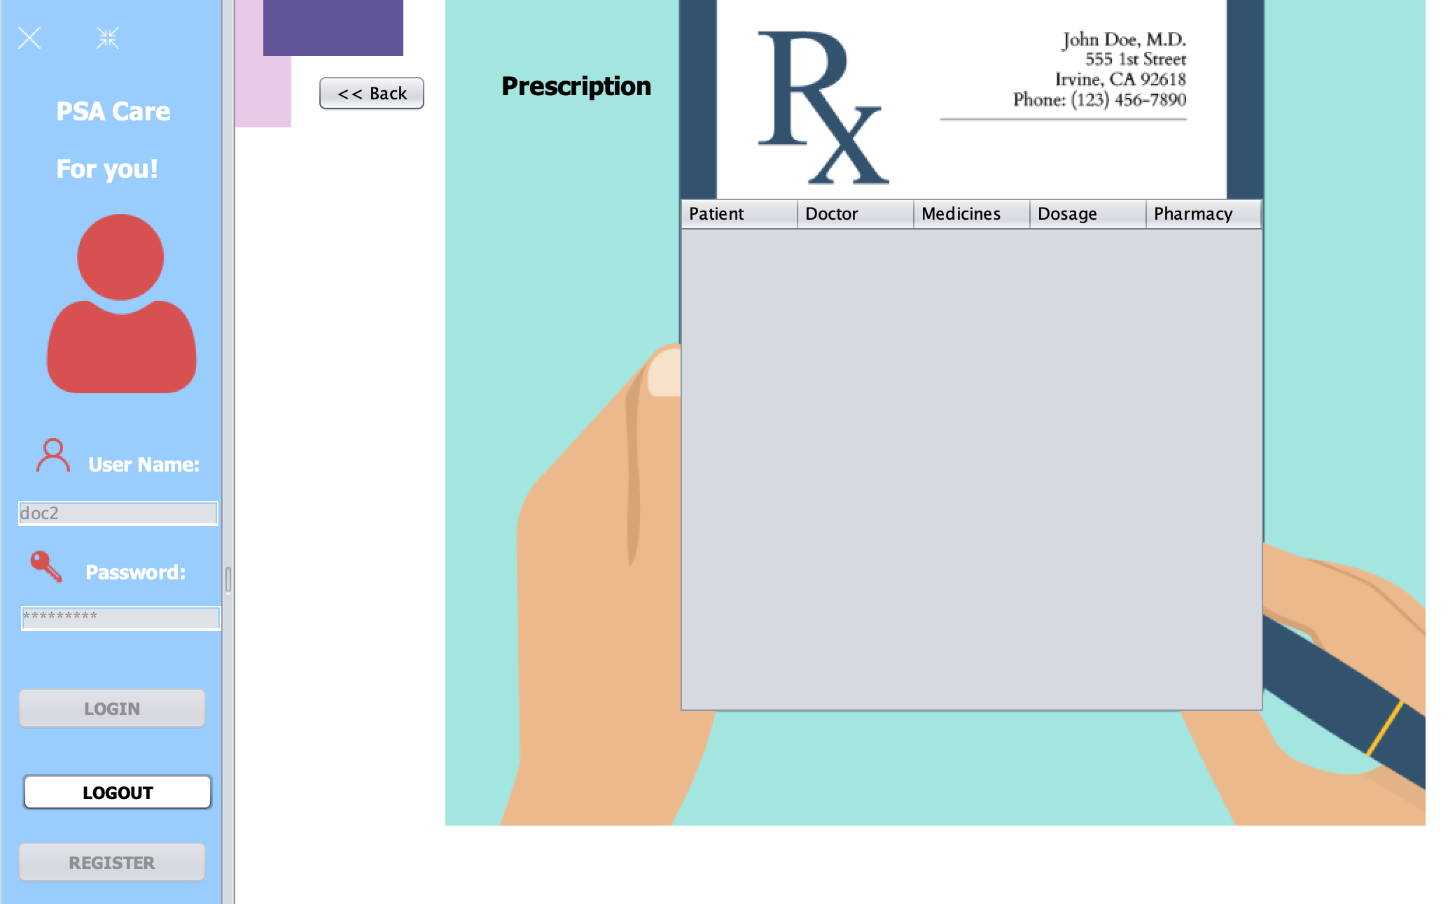

Slide 44
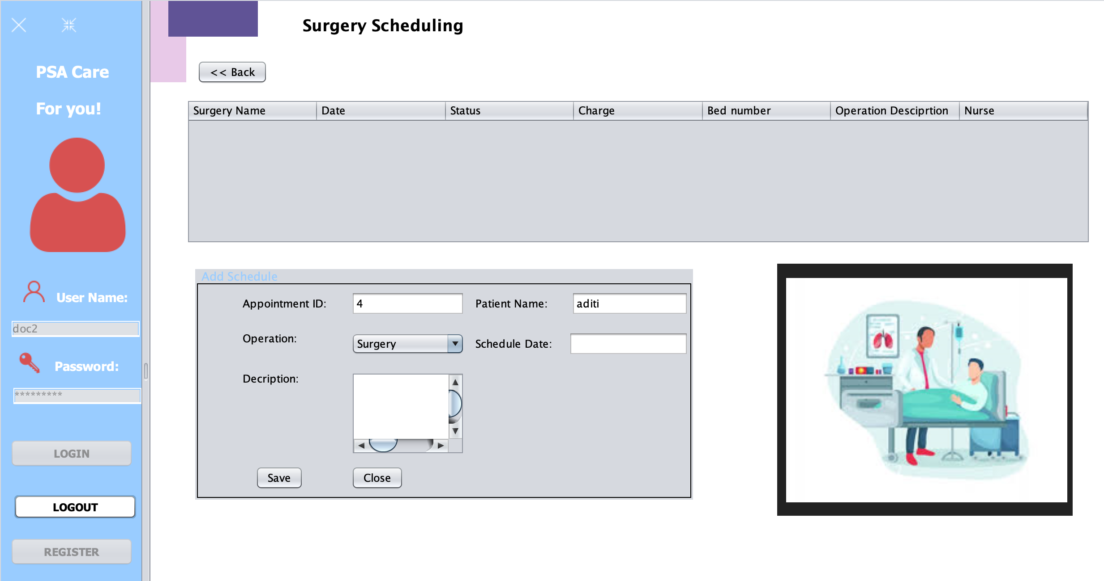

Slide 45
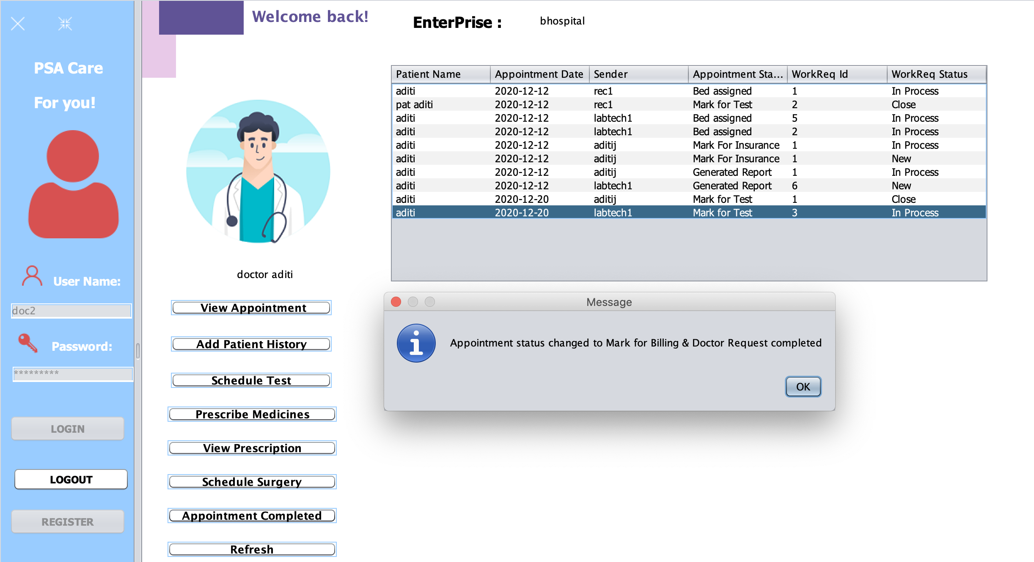

Slide 46
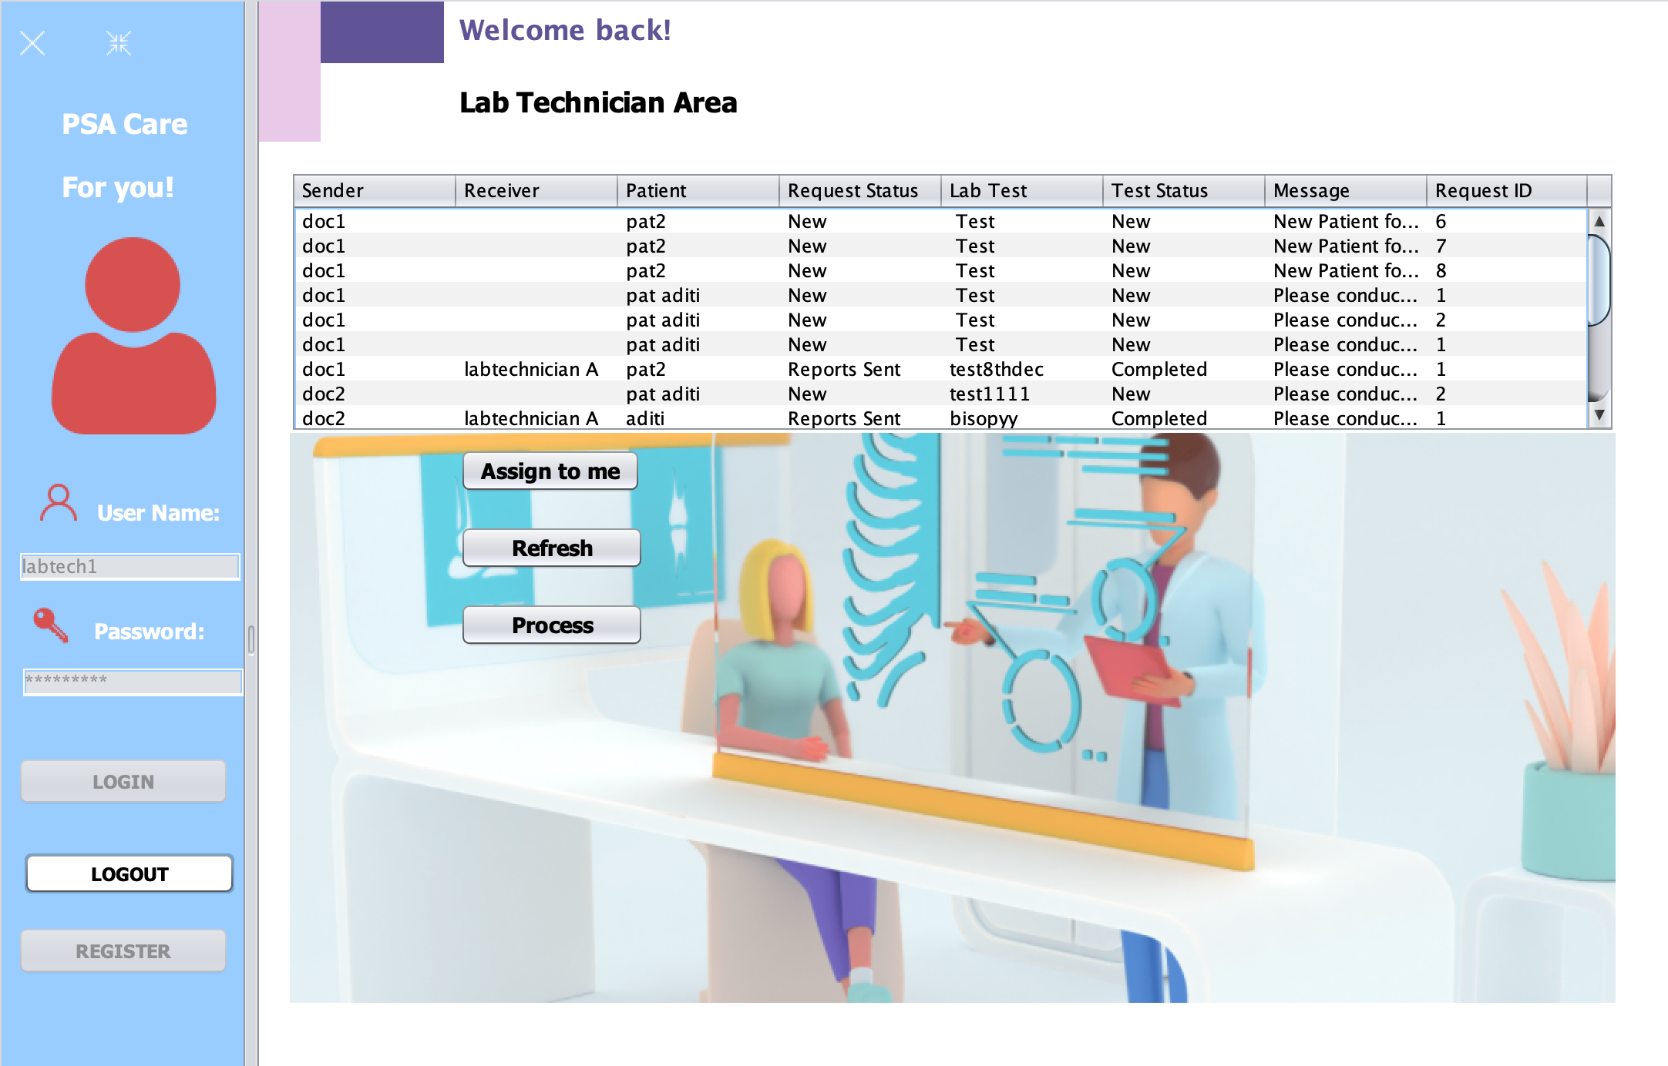

Slide 47
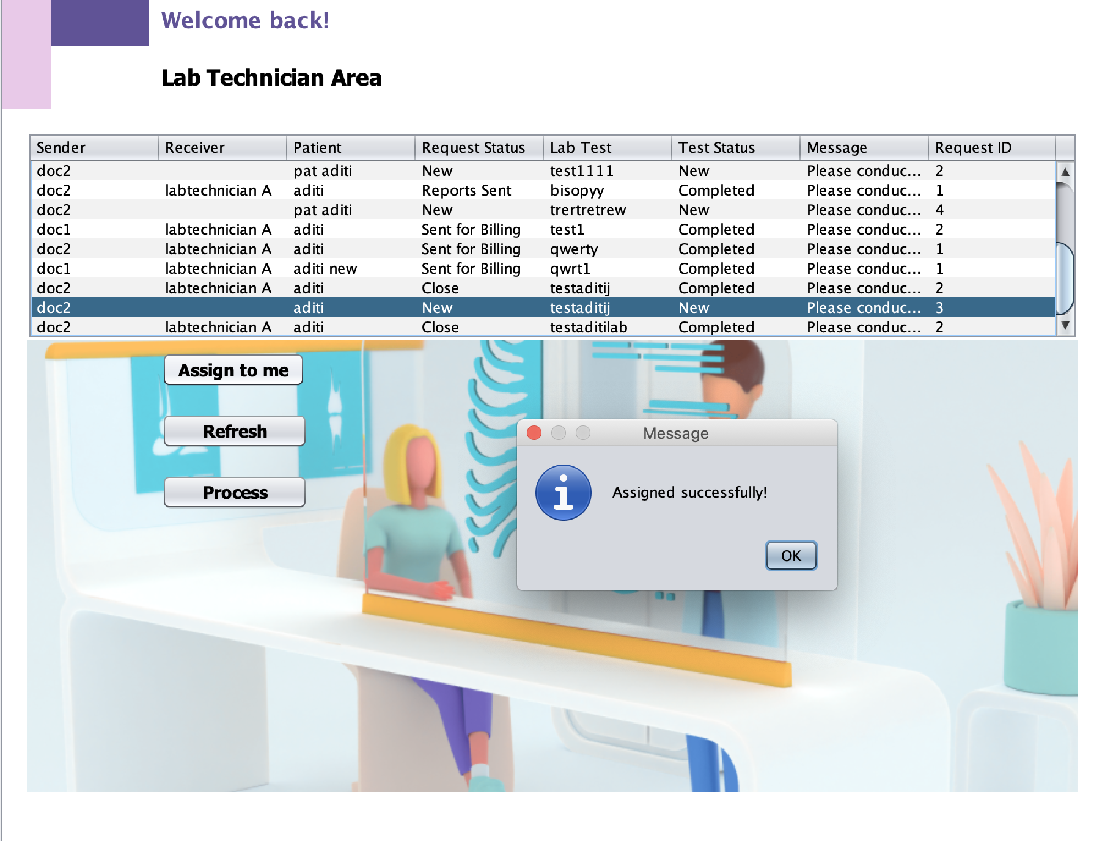
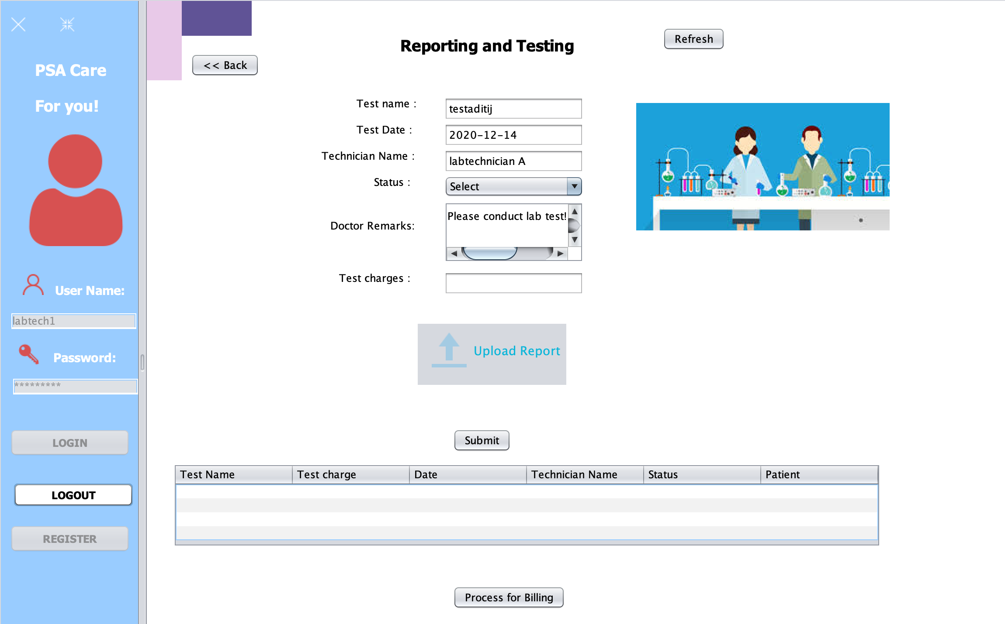

Slide 48
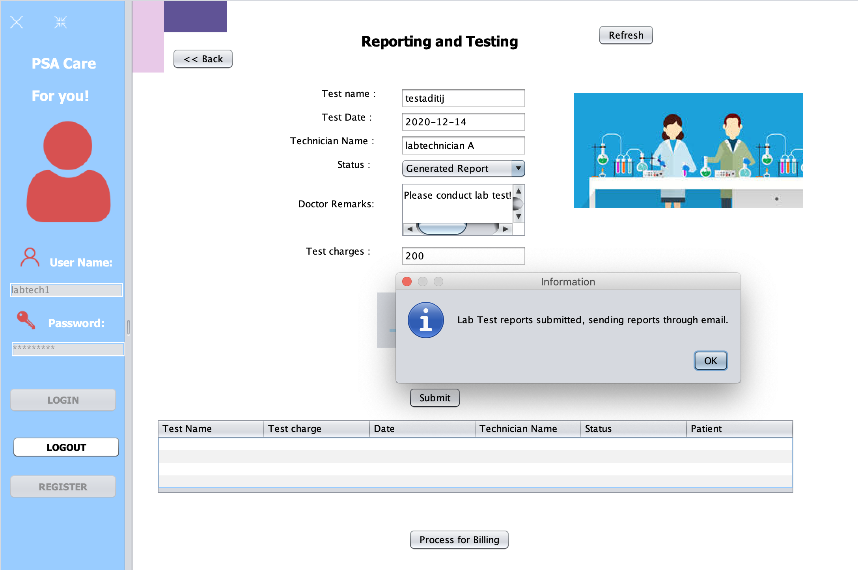
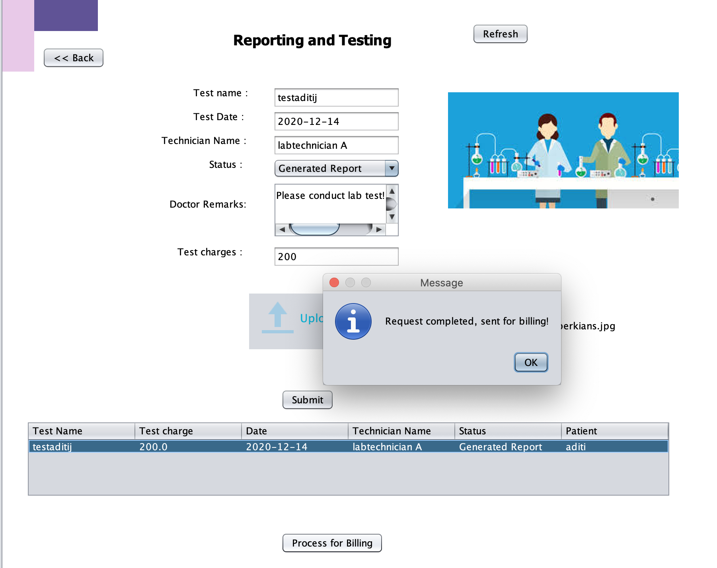

Slide 49
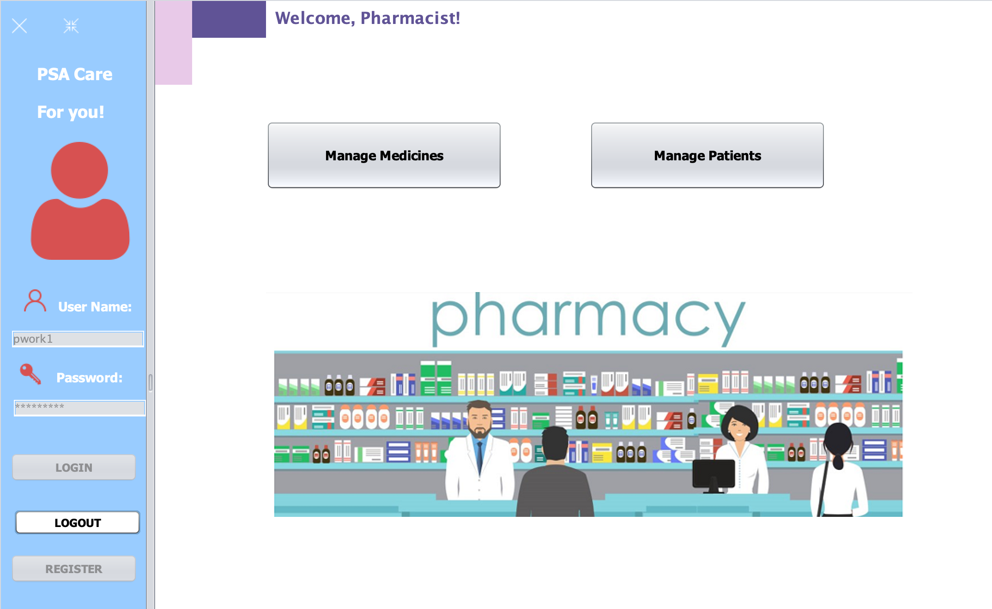

Slide 50
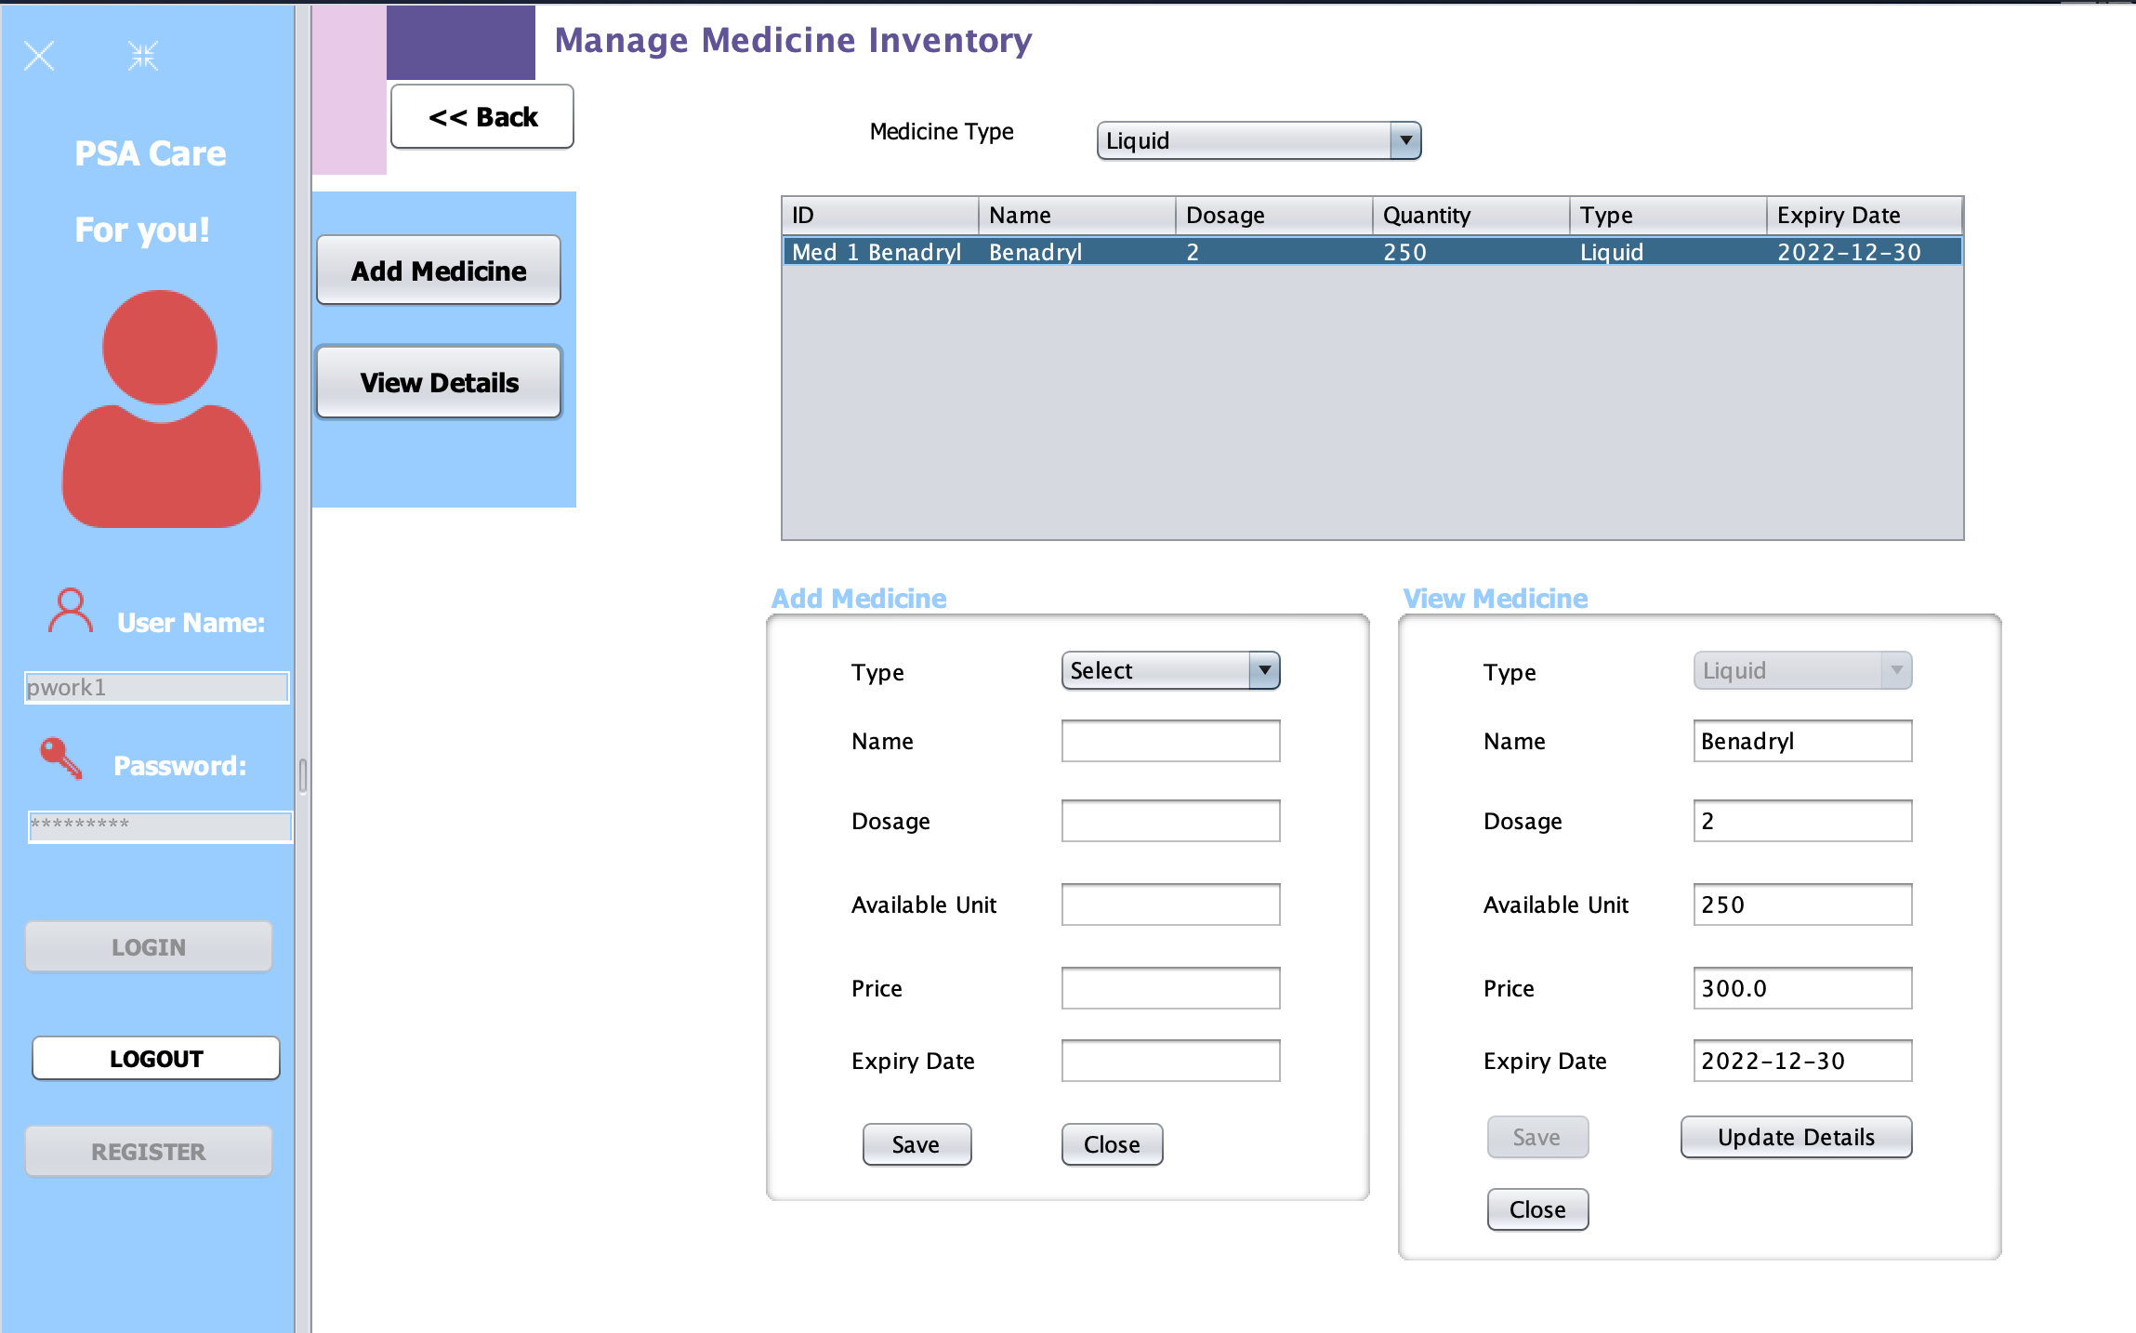

Slide 51
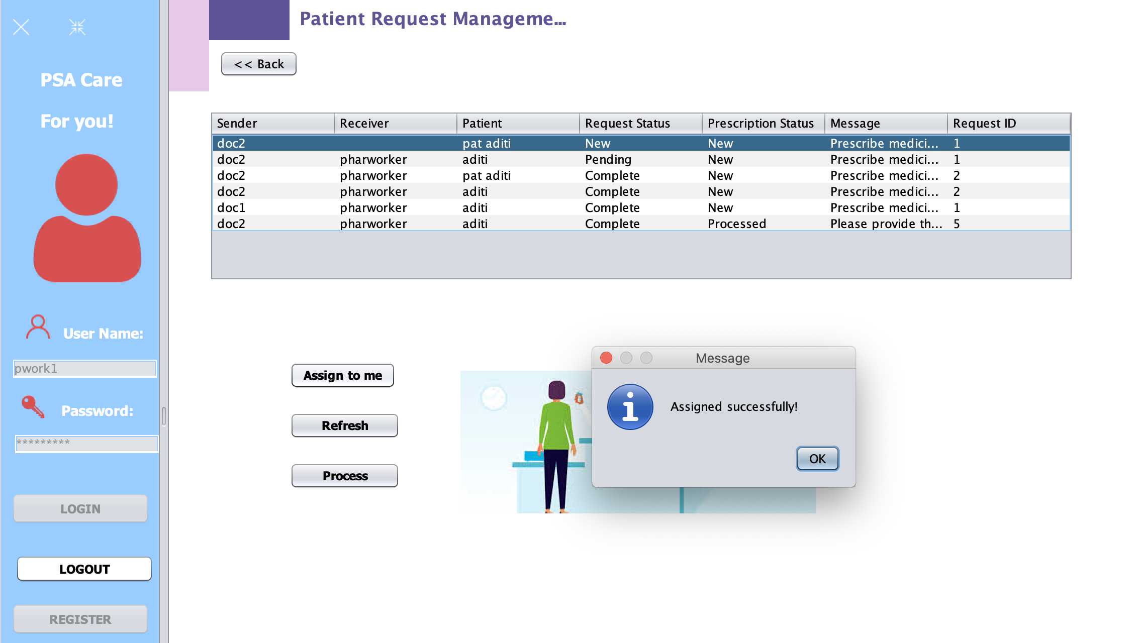
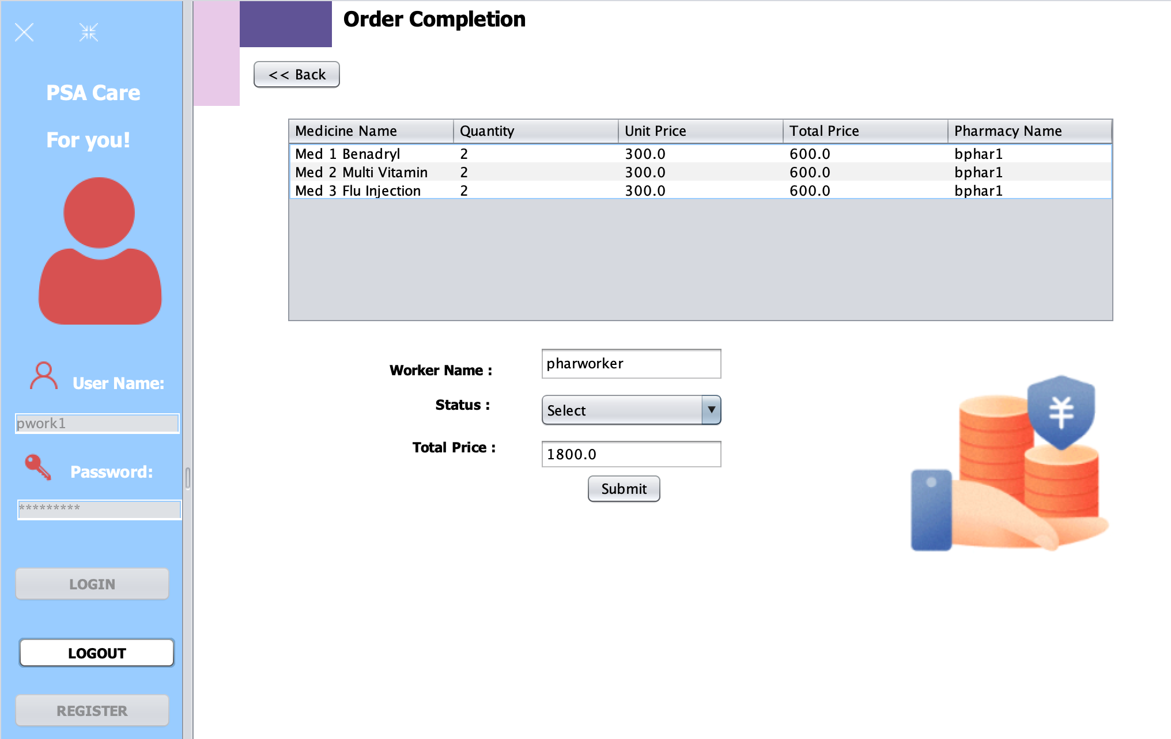

Slide 52
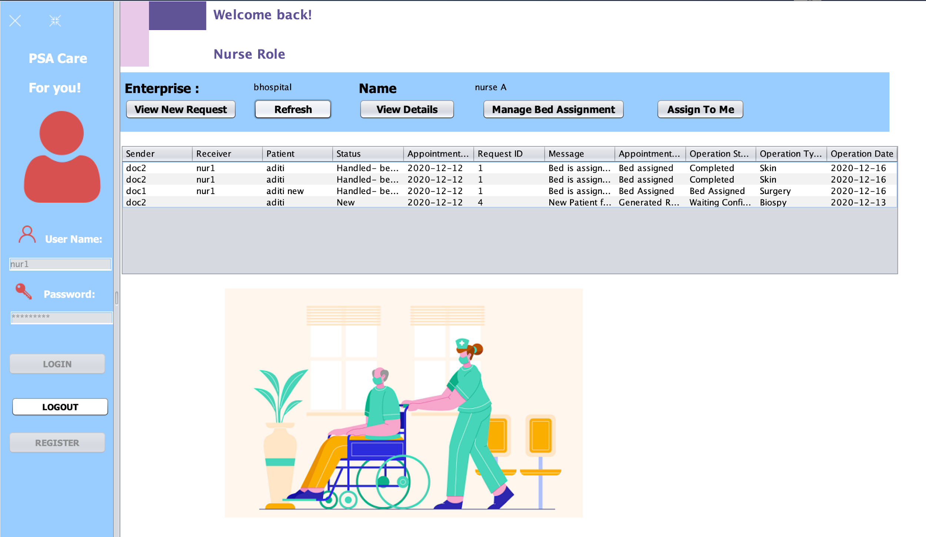

Slide 53
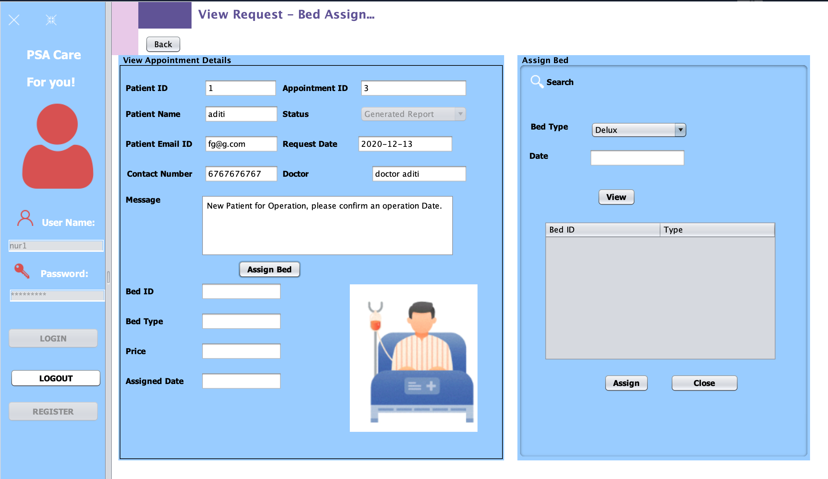

Slide 54
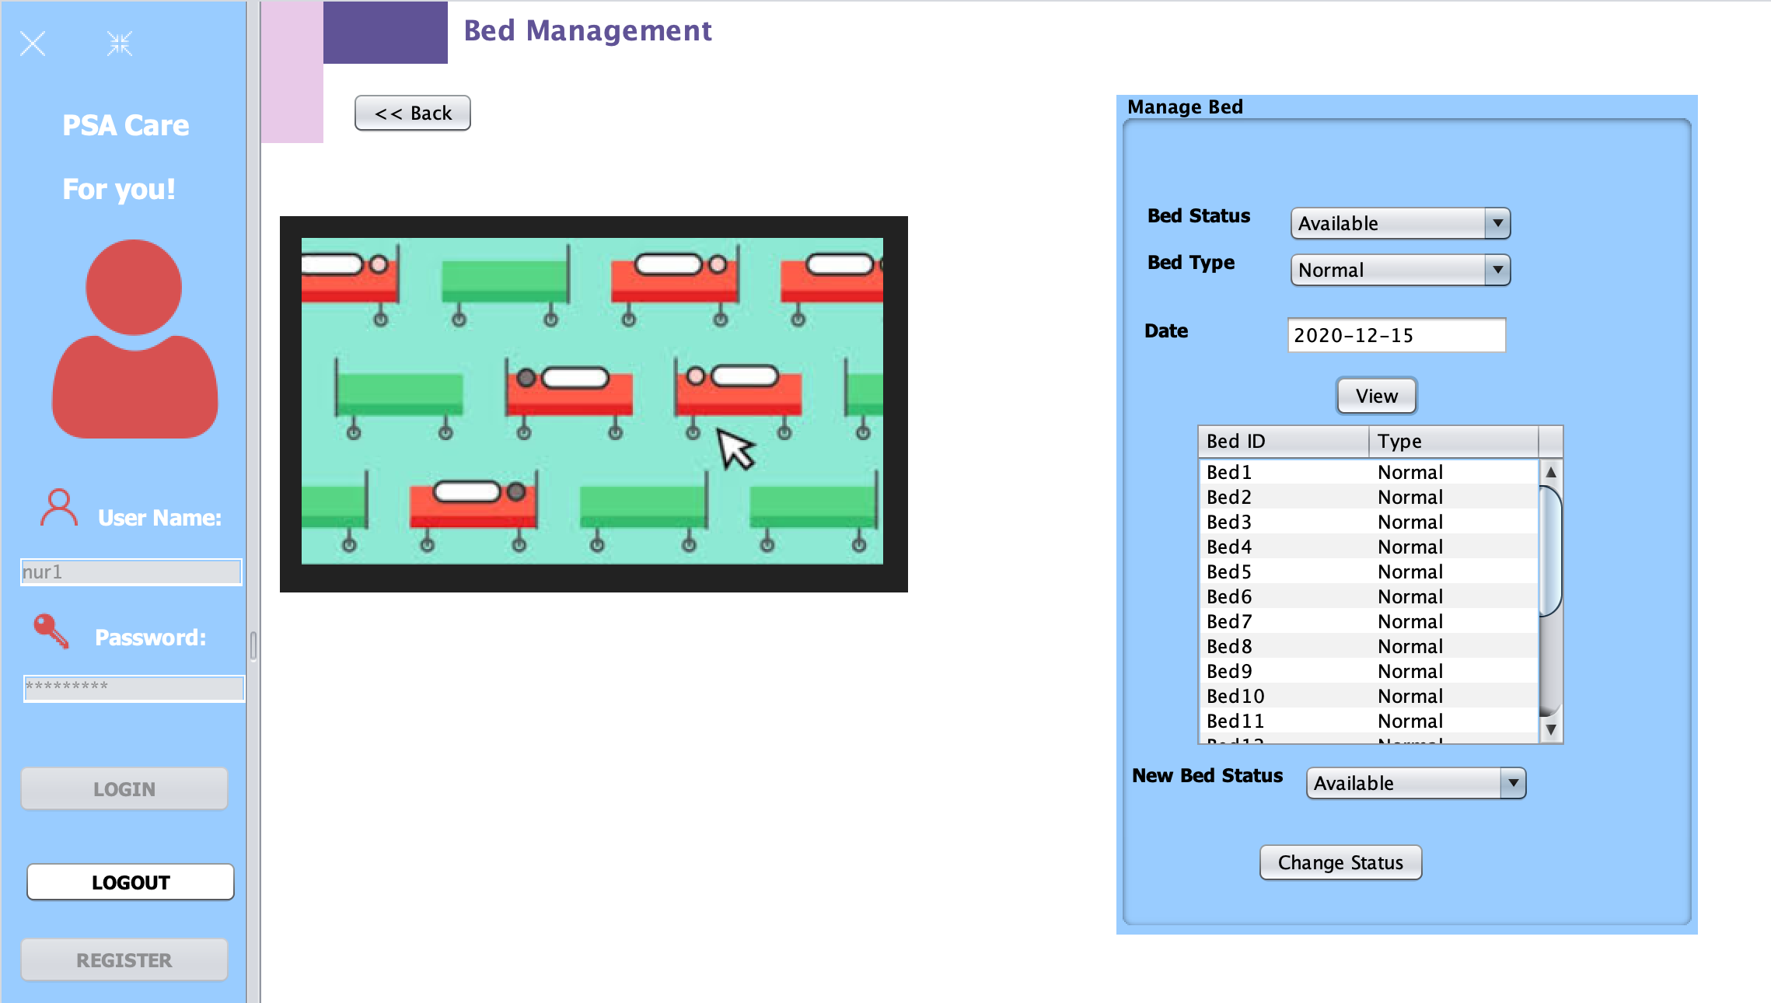


Slide 55


Slide 56


Slide 57


Slide 58

THANK YOU
ANY QUESTIONS?

